Slide 1
Contemporary philosophy

Slide 2
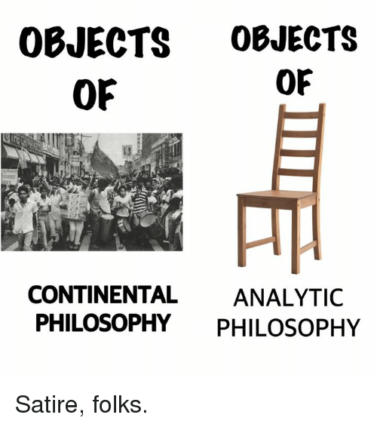
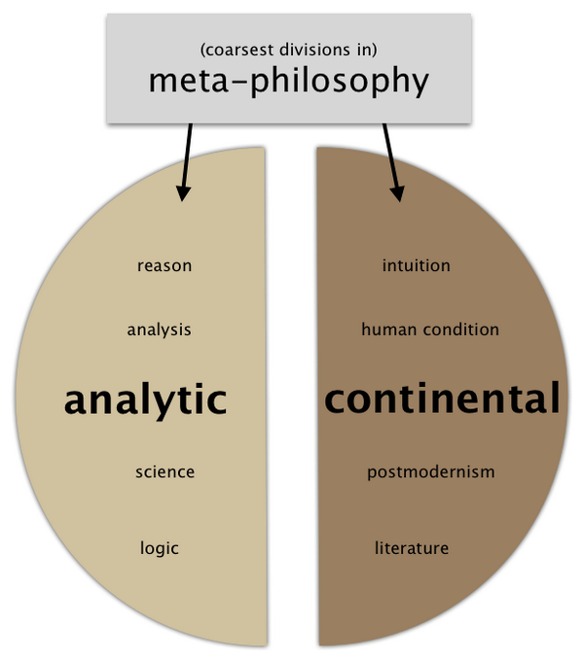
Contemporary philosophy is the present period in the history of Western philosophy beginning at the end of the 19th century with the professionalization of the discipline and the rise of analytic and continental philosophy.

Slide 3
Chair

Slide 4
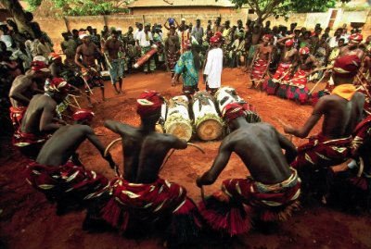
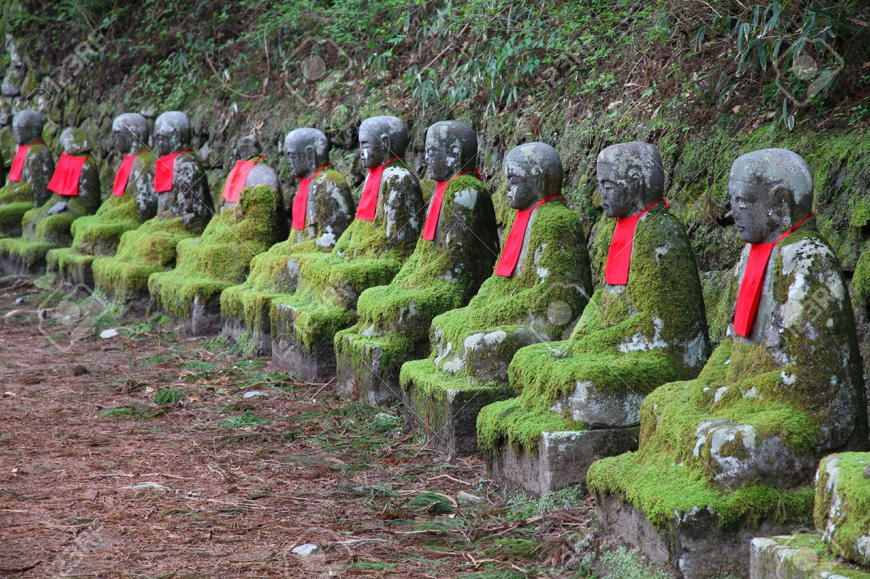
No - Chair

Slide 5
Continental philosophy usually considers these conditions of possible experience as variable. Determined at least partly by factors such as :
Social
context
Continental philosophers generally reject the view that the natural sciences are the only or most accurate way of understanding natural phenomena.
Language
Culture
Space
and
time
Continental philosophers often argue that science depends upon a "pre-theoretical substrate of experience" (a version of Kantian conditions of possible experience or the phenomenological “lifeworld") and that scientific methods are inadequate to fully understand such conditions of intelligibility.
History
Chair

Slide 6
Professionalization of philosophy:
Philosophy of life
Phenomenology
Existentialism
Utilitarianism
Post-structuralism
Structuralism
Marxism
Neo-marxism
Positivism
Functionalism
Hermeneutics
Bioetics
Psychoanalysis
Representationalism
Philosophy of mind
Neotomism
Intuitionalism
Post-modernism

Slide 7
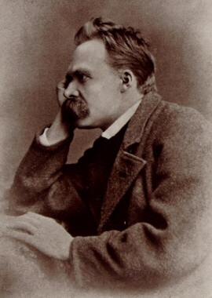
Nietzsche’s philosophy of life
Born in 1844, Nietzsche came from a long line of Lutheran ministers (father, grandfather)
Studied “Classics” and became a brilliant professor
Left the University to live in solitude and write
By his mid-40s, Nietzsche began his life-long battle with his mental illness (engendered by syphilis)

Slide 8
- By the 1890s, he became internationally known, although he knew nothing of success
In 1900, at age of 56, Nietzsche died in an insane asylum.
His Life-Long Goal: He was committed to teaching us how to live life to the fullest
This could best be done in a godless, meaningless world!

Slide 9
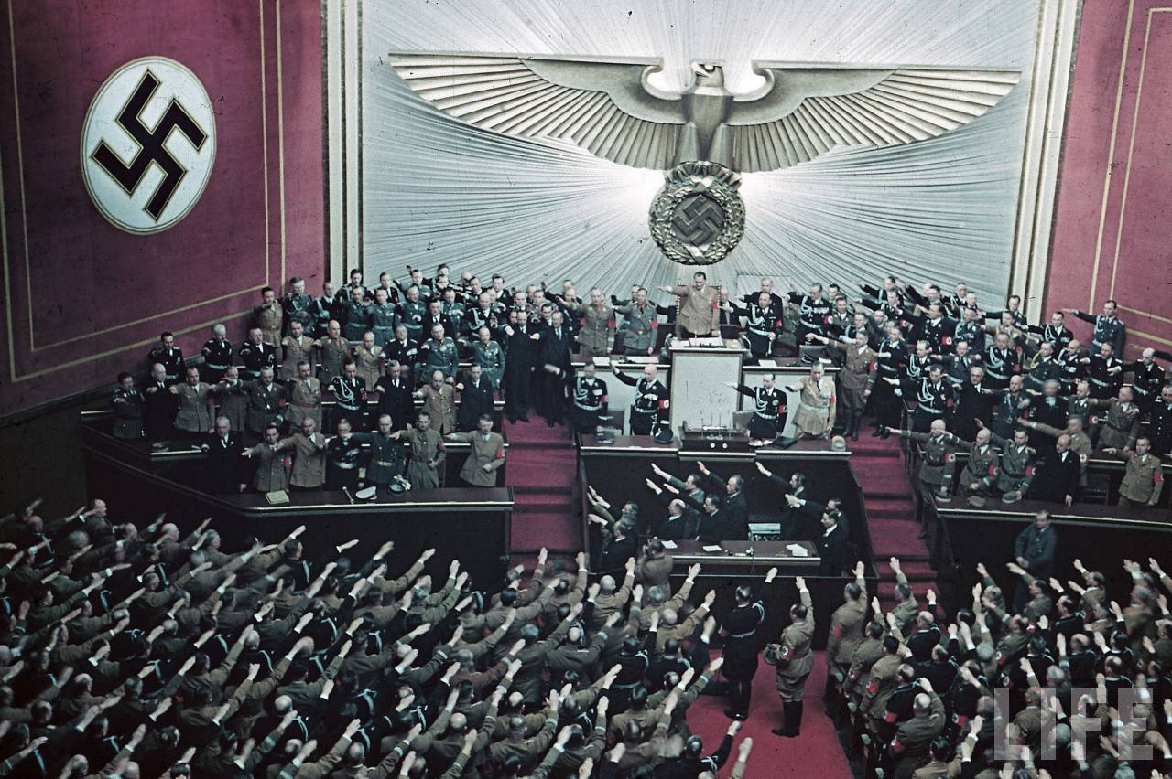
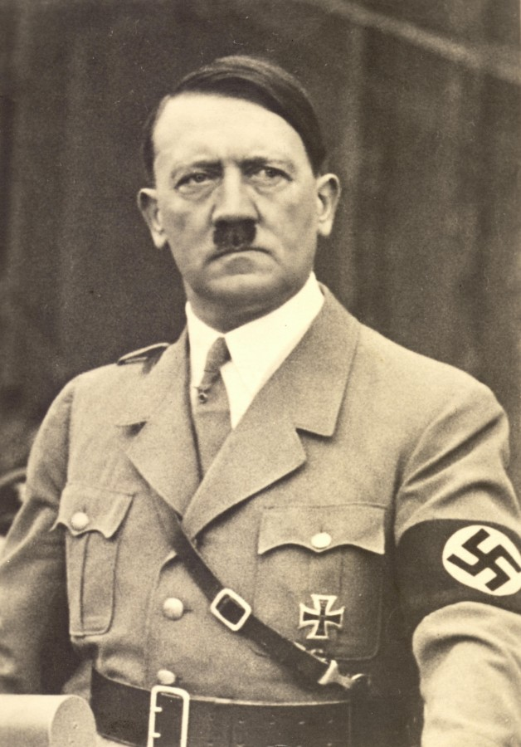
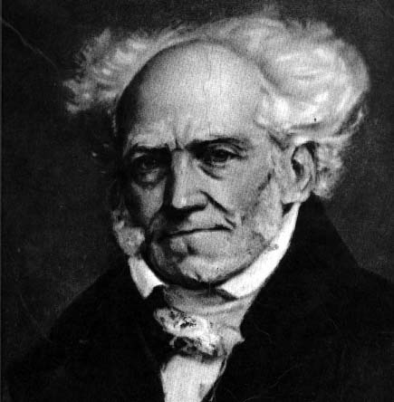
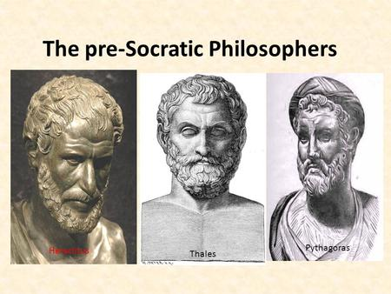
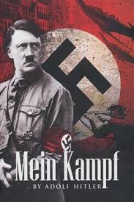
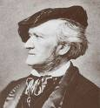
The Nietzsche’s philosophy roots
Schopenhauer
- Had an idealism of The Master Race, which gave a great influence on Hitler's highest men, quoted in Hitler's speeches.
Richard Wagner
Romanticism

Slide 11
Periodization of Writings:+
1
Juvenilia
before 1869
He composed music, wrote poetry and plays, and in 1863 produced an autobiography (at the age of 19). He also produced more serious and accomplished works on themes related to philology, literature, and philosophy.
Notes:
+ Nietzsche scholars commonly divide his work into periods, usually with the implication that discernable shifts in Nietzsche’s circumstances and intellectual development justify some form of periodization in the corpus.

Slide 12
Periodization of Writings:
1
the early period
1869-1876
Nietzsche’s writings during this time reflect interests in philology, cultural criticism, and aesthetics. He was influenced intellectually by the philosopher Arthur Schopenhauer and emotionally by the artist Richard Wagner.
The Birth of Tragedy 1872
Saw these as the Greeks’ way of overcoming pessimism
Focused on Greek theater (especially drama) and music
Notes:
+ Nietzsche scholars commonly divide his work into periods, usually with the implication that discernable shifts in Nietzsche’s circumstances and intellectual development justify some form of periodization in the corpus.

Slide 13
Richard Wagner (1813-1883)
Met in 1868
Became a father figure for Nietzsche
Nietzsche saw him as the reincarnation of Greek tragedy
Heavily influenced Nietzsche’s understanding of art
Broke with Wagner due to anti-Semitism and Parsifal

Slide 14
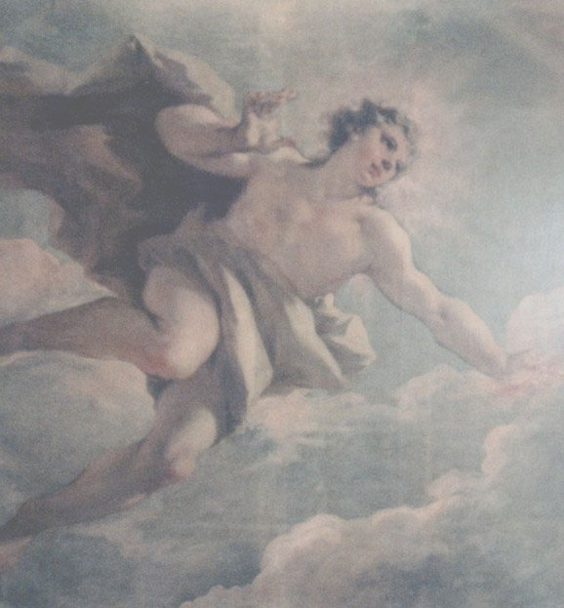
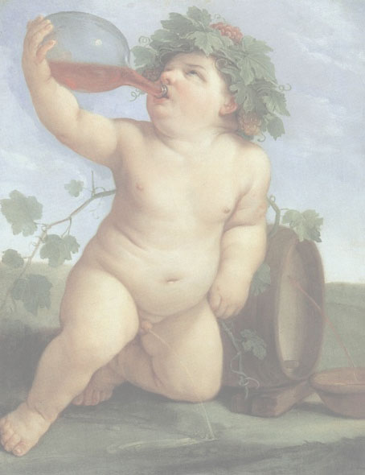
Apollo vs. Dionysus
Art as a form of monument
Reverence of the past
Rationality and logic
Order
Art as an experience
Focus on the present
Emotion
Chaos and freedom

Slide 15
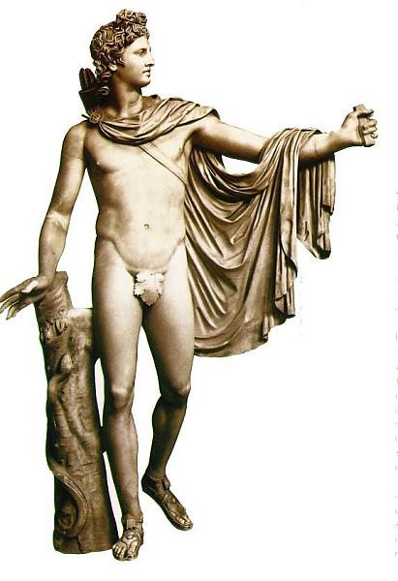
The Apollonian
The Dionysian
Apollo was charioteer of the sun and the god of reason
The Delphic Oracle, an oracle of Apollo, inspired the mission of Socrates
Represents life as a problem that must be solved through reason and principle
Dionysus (Roman: Bacchus) was god of wine
His dismemberment by the gods was recreated in traditional bacchanalia
Represents passion and the overcoming of pessimism through celebration

Slide 16
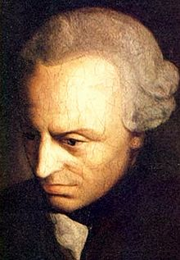
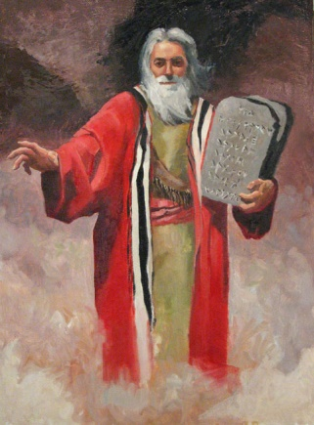
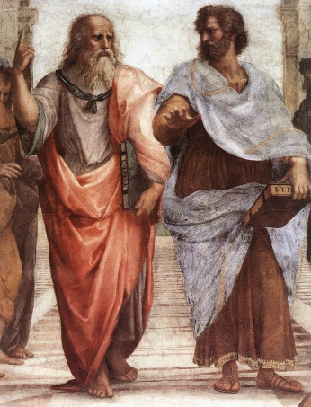
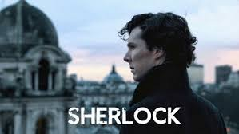
Apollinian style
Music and Art: Johann Sebastian Bach, Duke Ellington, George Gershwin,
Religion and Philosophy: Moses, Confucius, Plato, Rene Descartes, Immanuel Kant
Fictional: Captain America, Sherlock Holmes, Superman, Yoda

Slide 17
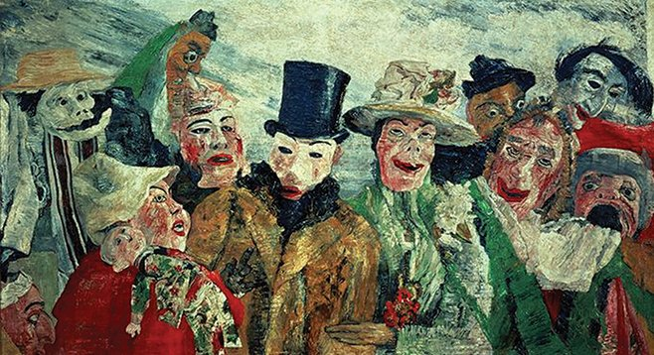
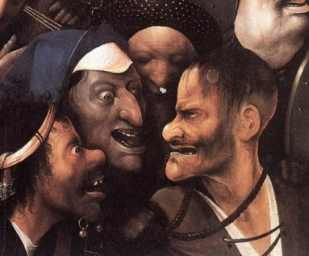
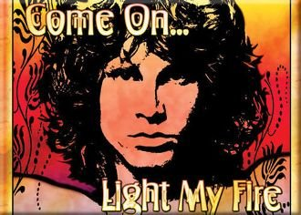
Dionysian style
Music and Art: Heironymous Bosch, James Ensor, Jim Morrison+, Little Richard, Elvis Presley
Religion and Philosophy: Carvaka, Ezekiel, Friedrich Nietzsche
Fictional: Iron man, Guardians of the Galaxy, Austin Power
Notes:
+ James Morrison - Rebellious Youth
Morrison moved frequently as a child due to his father's naval service, first from Florida to California and then to Alexandria, Virginia, where he attended George Washington High School. As a teen, Morrison began to rebel against his father's strict discipline, discovering alcohol and women and bristling at various forms of authority. "One time he told the teacher he was having a brain tumor removed and walked out of class," his sister Anne recalled. Nevertheless, Morrison remained a voracious reader, an avid diarist and a decent student. When he graduated from high school in 1961, he asked his parents for the complete works of Nietzsche as a graduation present—a testament to both his bookishness and rebelliousness.

Slide 18
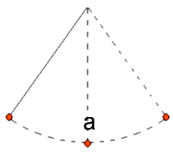
Apollo Dionysus
Art as a form of monument
Reverence of the past
Rationality and logic
Order
Art as an experience
Focus on the present
Emotion
Chaos and freedom
Western philosophers since Socrates represent a degeneration of the natural strengths of humanity. A noble taste for heroic styles of life can only be corrupted and undermined by the interminable debates of dialectical reason. Traditional Western morality philosophy—and the Christian religion in particular—therefore opposes a healthy life, trying vainly to escape unfortunate circumstances by destroying native human desires.

Slide 19
III - 1877-1882—the middle period
During this time Nietzsche liberated himself from the emotional grip of Wagner and the artist’s circle of admirers, as well as from those ideas which (as he claims in Ecce Homo) “did not belong” to him in his “nature” (“Human All Too Human: With Two Supplements”
Nietzsche discovers that “one thing is needful” for the exemplary human being: to craft an identity from otherwise dissociated events bringing forth the horizons of one’s existence.

Slide 20
The Horizon (In The Use and Abuse of History)
Every society has a Moral Horizon
These are absolute statements about how we should live
They inform citizens what is morally right and wrong
Great men create horizons for us:
Plato, Locke, Hegel, Buddha, Jefferson, and Jesus
They all believe they “discovered,” not created truths

Slide 21
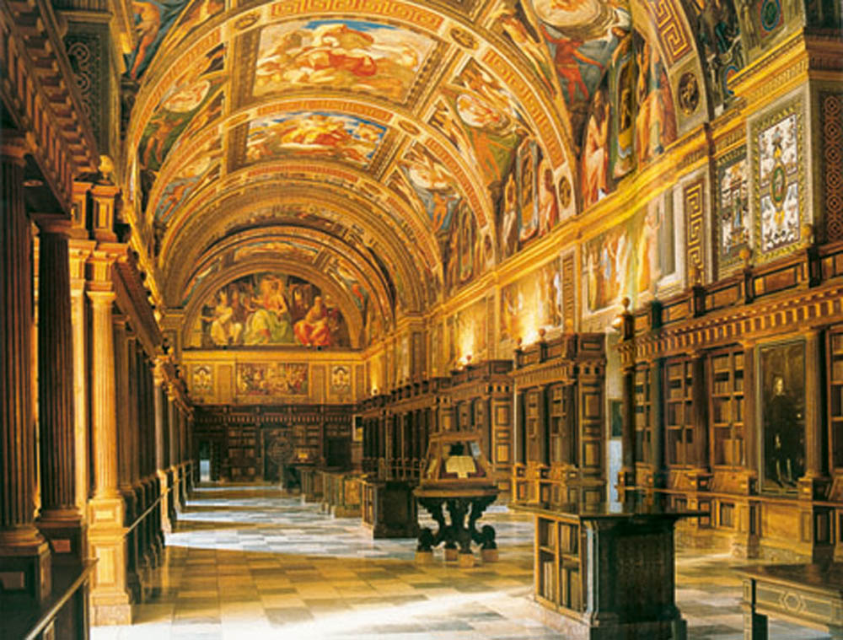
In the best Civilizations, the Moral horizon allowed the weak, the incompetent, and the stupid to be eliminated through a natural process
Survival of the species
Western civilization
Moralists like Jesus said these values are wrong—that laws should protect the weak

Slide 22
The Consequences of Christianity’s Moral Horizon
This code became the dominant moral “horizon” in Europe
Christianity triumphed over Rome (a strong culture)
Today, Christian morals go unquestioned and unchallenged by most of us
How: The process of condemning Strength and encouraging a welfare state has been accomplished by convincing society that this new Christian moral code is the perfect, absolute, divine code of the Universe
Society now unquestionably accepts Christian morality as a transcendent “moral horizon”
The Consequence: Natural leaders, the confident, the courageous, & the innovators are shackled by a value system that makes them equal with the masses

Slide 23
Horizons are only Perspectives
For Nietzsche, all horizons (including Christianity) are man-made perspectives in constant flux—not absolute Truths
1) All horizons are “created” by men
There is no truth outside man and society
Life has no meaning before we give it meaning
2) Each are mistaken as perfect & absolute
3) There are many possible perspectives one can take on any moral issue
4) Every perspective is limiting and incomplete
Use History and a soda can as examples

Slide 24
And Since Moral Horizons are Only Illusions . . .
Since there are no transcendental (coming to us from anywhere outside this world) ethics or values for us to use, we must create our own
Once we realize that we are the creators of human values, we are free to choose whatever values are best
And surely, we will choose the value system that has led us to greatness before Christianity
The natural process of weeding out the weak and empowering great men to do great things

Slide 25
IV - Post-1882—the later period
Nietzsche transitions into a new period with the conclusion of The Gay Science (Book IV) and his next published work, the novel Thus Spoke Zarathustra, produced in four parts between 1883 and 1885.
Philosophically, during this period, Nietzsche continues his explorations on morality, truth, aesthetics, history, power, language and identity. For some readers, he appears to be broadening the scope of his ideas to work out a cosmology involving the all encompassing “will to power” and the curiously related and enigmatic “eternal recurrence of the same.”

Slide 26
Slave vs. Master Morality (In Beyond Good and Evil)
Slave Morality
Be caring and sensitive to all
—place others first
—don’t be selfish
—be meek
—help the less fortunate
—sacrifice
For this is how a good slave is to act
Slave Morality imposes this will on the strong
Don’t be strong, assertive, aggressive, selfish
Work in the service of others, not yourself
Those who do not, are going to hell and are evil

Slide 27
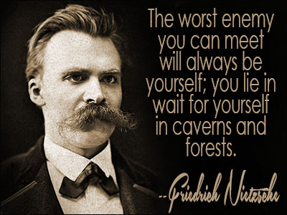
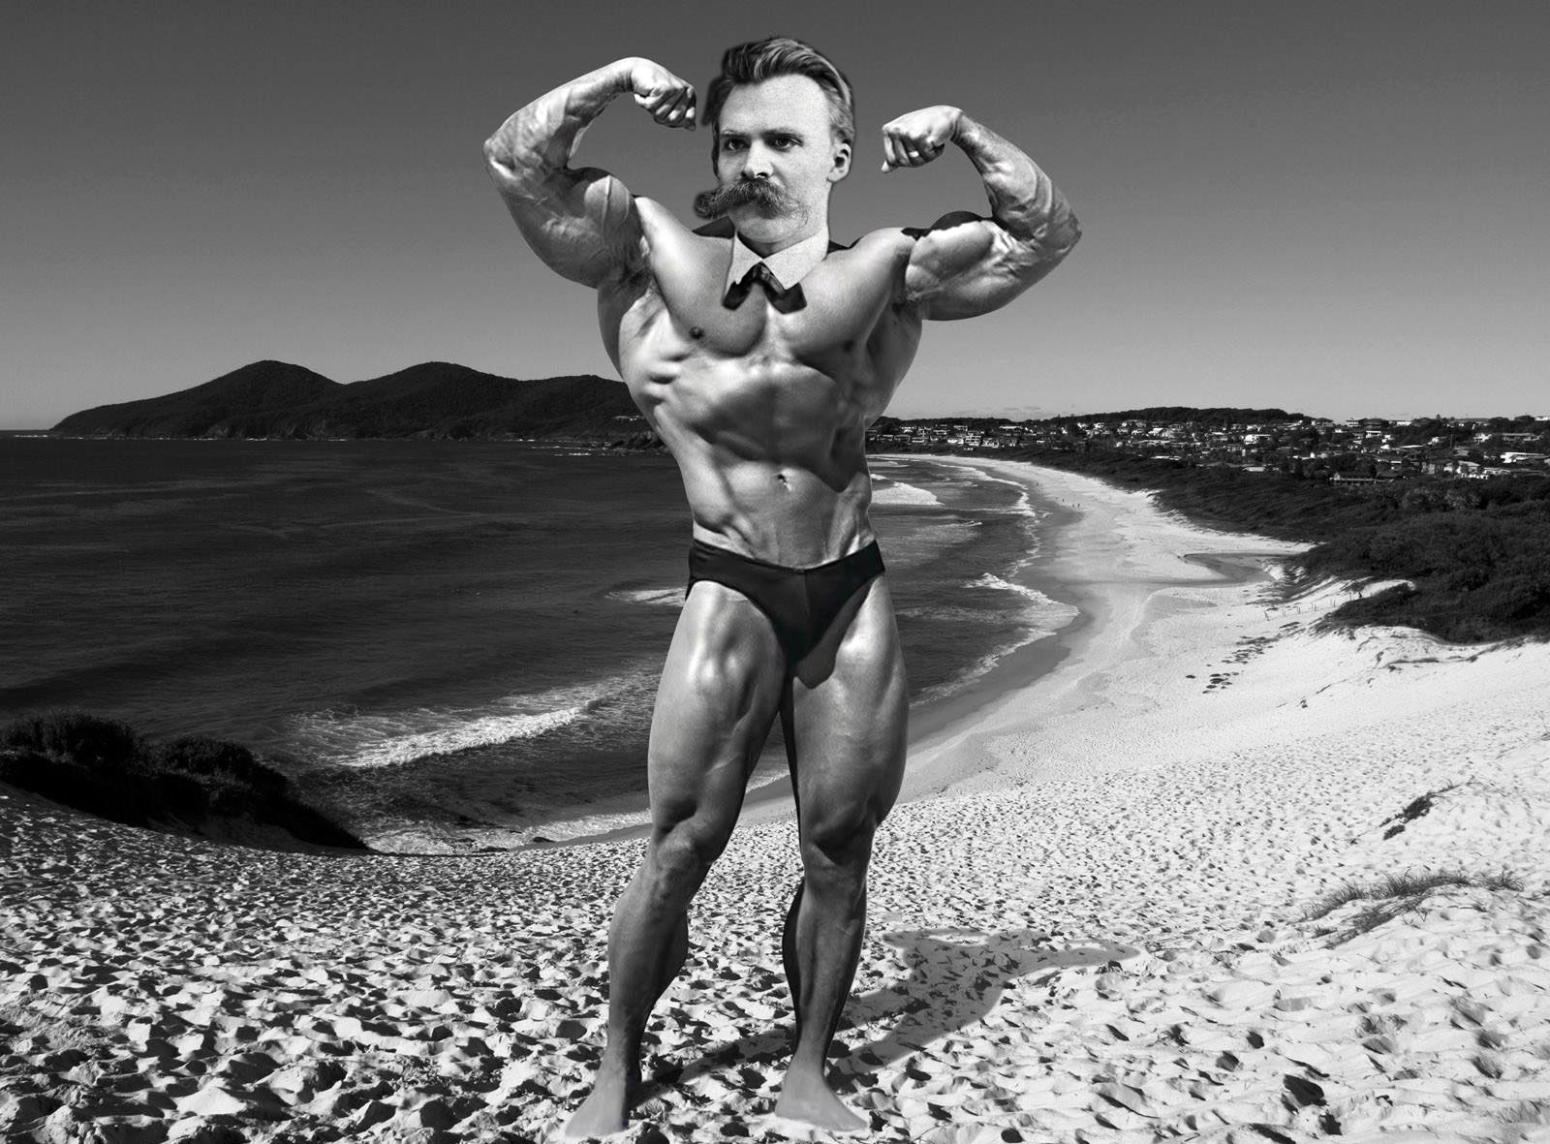
Slave vs. Master Morality (In Beyond Good and Evil)
Slave Morality
B) Master Morality
Be caring and sensitive to all
—place others first
—don’t be selfish
—be meek
—help the less fortunate
—sacrifice
For this is how a good slave is to act
Slave Morality imposes this will on the strong
To be great, we must break away from that false thinking
This thinking prevents men from being great individuals
Christianity creates mediocrity
It shackles great men to the mundane and average
Master Morality would encourage us to be unequal, warriors, and rise above the weak, stupid, and meek
Let the strong rise to the top of the heap +
Notes:
+ - Nietzsche hates Christianity
1) It is a social construct but the masses blindly follow it as if it were “T”ruth
2) It forces men to following the teachings of God, not their greater and more powerful instinct (the Will to Power)
3) Under threat/fear, it forces men to value Humility not Pride, Equality not Individualism, Timidity not Aggression, and Others not Yourself
He hates Democracy, Socialism, and Communism
1) They let the idiots run the system
2) All are based on equality—even though we are not all equal—some men are greater!(p. 837)
3) The masses of weak always win out while the few strong thinkers are forced to comply

Slide 28
Turning Good into Evil
(Christianity’s Moral Inversion)
The Romans & Pre-Socratics Greeks followed their Natural Instinct:
BAD
GOOD
was the weak, timid, sacrificial, and passive
was strong, assertive, individualistic, bold, powerful, and vigorous
Christianity turned the old category of “Good and Bad” on its head and replaced it with “Good and Evil”+
Notes:
+ Before Christianity, following our natural instinct to be great (master morality) was “Good”
Suppressing it was “Bad”
There was no concept of evil associated with nature
After Christianity, our instinct to be great became “Evil” (slave morality)
Suppressing it became “Good”
Now, our nature is inherently evil

Slide 29
Turning Good into Evil
(Christianity’s Moral Inversion)
Christianity forces us to deny our Natural Instinct and view it as evil
EVIL
GOOD
is the meek, timid, sacrificial, passive, nurturing
is strong, assertive, individualistic, bold, powerful, and vigorous
God, and his morality, must DIE if things are going to change and man is to be FREE to follow his Will To Power.
The primary focus is on fighting EVIL
This leads all of society to suffer for man can no longer strive for individual greatness and boldness without overwhelming guilt and fear of hell. +
Notes:
+ Think how much greatness & human potential has been lost and squandered over the centuries
For every one Van Gough, Free Jazz Musician, Dreamer, Rugged Individualist, and Experimental Poet following their “call to greatness,” billions of others have done nothing because of the foolish Christian mentality that told them “to serve others” for “their reward is in heaven”

Slide 30
The Death of God
God dies when men realize they created God—not vise versa. +
And with God’s death, also comes the death of Universal ideas and Truths
Our Science kills God and our belief in Absolutes
Science explains everything from creation to the Big Bang
Notes:
+ God is dead. God remains dead. And we have killed him. How shall we comfort ourselves, the murderers of all murderers? What was holiest and mightiest of all that the world has yet owned has bled to death under our knives: who will wipe this blood off us? What water is there for us to clean ourselves? What festivals of atonement, what sacred games shall we have to invent? Is not the greatness of this deed too great for us? Must we ourselves not become gods simply to appear worthy of it?
—Nietzsche, The Gay Science,

Slide 31
Superman & His Will To Power
The Death of God will liberate others
A godless, meaningless world is FREEDOM!
It is a great opportunity to do great things
Life becomes a blank page for us to write our own life story
God’s death gives us Liberation: from guilt, to be creative, to construct one’s own horizon and to follow your own will to power

Slide 32
What is our Will To Power?
For Nietzsche, it is man’s internal drive for greatness and creativity
He is the one that sees possibilities in the lost horizon
He even may need to be cruel and disconnected
Risks making yourself into a new god
NO
It is the voice in our head/heart that tells us to strive to rise above the masses (not take care of them) and to master everything

Slide 33
Eternal Recurrence

Slide 35
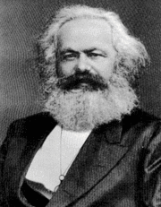
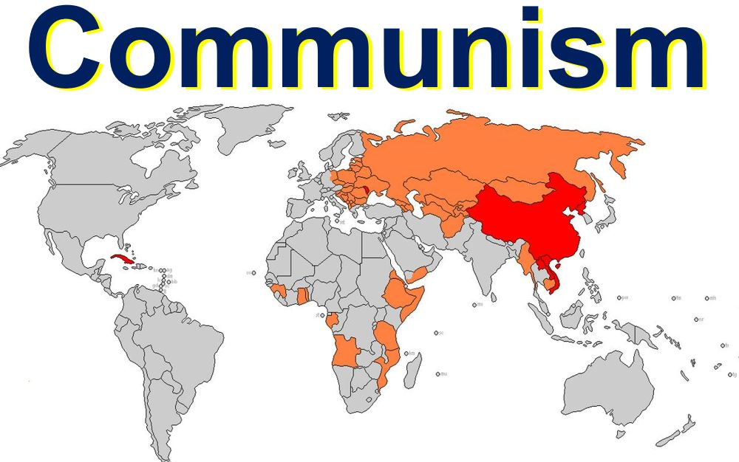
Philosophy of Marx
Communism
Marx

Slide 36
University educated - philosophy/law/history
Strongly influenced by circle of intellectuals around university – “Young Hegelians”
Worked as journalist/newspaper-magazine editor/writer
Left Europe for England in late 1840s due to political pressure
Supported by friend/collaborator Friedrich Engels for much of his adult life

Slide 37
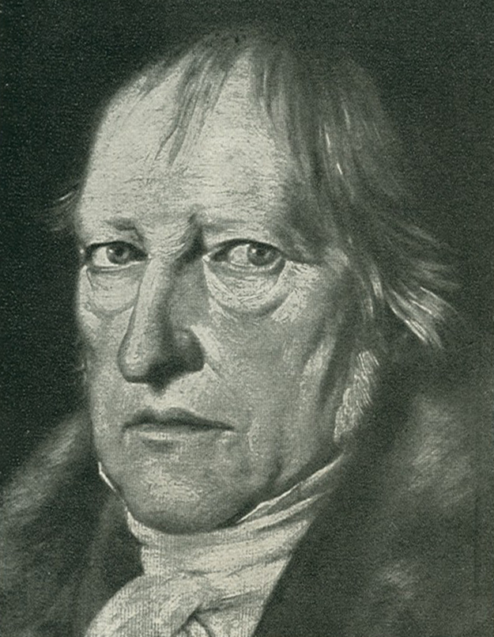
Hegel’s Influence on Marx
Emphasized the idea of philosophy as a practice
Historicity of knowledge; reality is a living, evolving system.
Emphasized the economic nature of society in The Philosophy of Right; many of Marx’s earliest writings are examinations of this work

Slide 38
Marx I
Marx II
Early/Young Marx (1848)
Humanisitic
“Alienation”
Main Works
Economic and Philosophic Manuscripts of 1844
Theses on Feuerbach (1845)
[A Critique of] German Ideology (1845)
Later Marx
Political
“Revolution”
Main Works
Communist Manifesto (1848)
Das Kapital (1867)

Slide 39
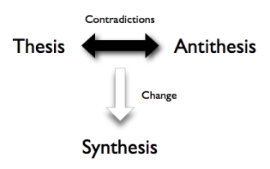
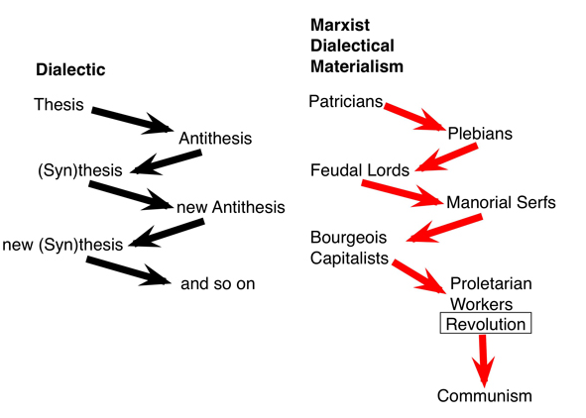
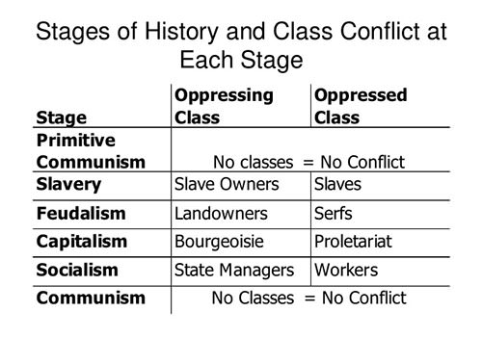
Thesis generates its antithesis
In principle this never ends, though Hegel in fact ends this process in his philosophy and the Prussian state
Out of the conflict of these arises a synthesis which serves as a new thesis
Historical process of development: intellectual, moral, political, social, etc.
The Dialectic

Slide 40
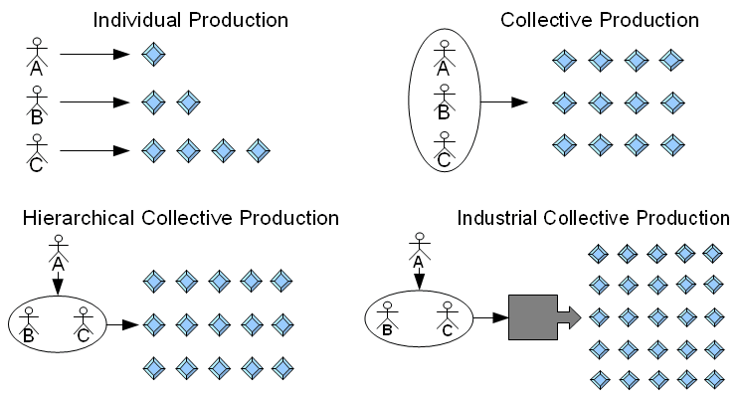
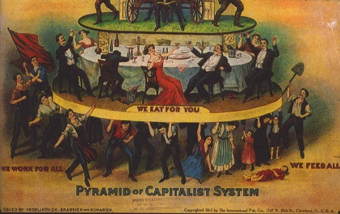
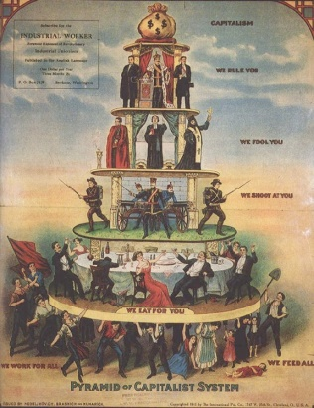
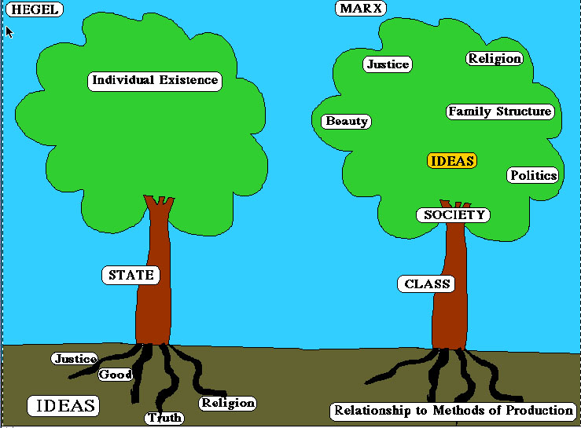
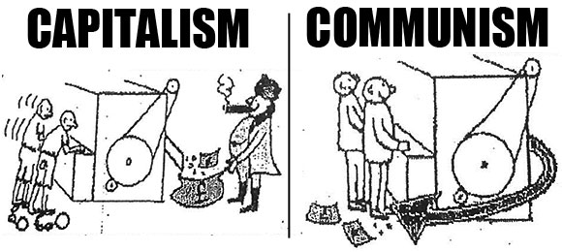
Dialectical Materialism
- Fundamental reality is purely physical
- All behavior is law-governed
- Social structures are determined by the mode of economic production
Each mode of production leads to “contradictions”—problems inherent to the system that can’t be solved within the system—thus economic development is dialectical
Material conditions – social location – determines thought
Ideas serve material interest
History is the history of class conflict
Utopian element: economic development is inevitable, and terminates in communism

Slide 41
Material conditions – social location – determines thought
Eventually members of a social class recognize their common interest. They shift from being a class in-itself to being a class for-itself.
False consciousness – seeing the world through a lens that is convenient to other classes – can stand in the way of (critical) class consciousness.

Slide 42
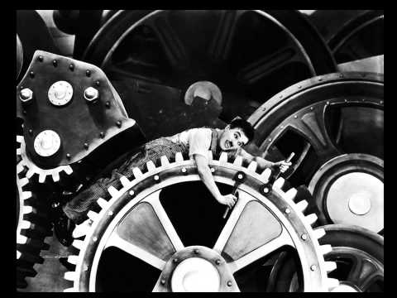
Alienation
Definition : separation within a person of things that ought to be connected, especially a loss of control over aspects of one's life.
Capitalist working conditions alienate labor
Cash wages dehumanize product of labor
In other words…
- Least human do what is only human, most human do what we have in common with animals
Separating worker from creation
Worker as mere appendage of machine

Slide 43
Existentialism Overview
a 20th-century philosophical movement; assumes that people are entirely free and thus responsible for what they make of themselves
posits that individuals create the meaning and essence of their lives, as opposed to it being created for them by deities or authorities
believes that confusion and disorientation are inherent to the human condition in response to a meaningless, absurd world

Slide 44
What do Existentialists believe?
Existentialist believe that existence is more important than essence (and that the only way to really have an essence or be a person is to act/experience)existence = acting, doing things, making choices essence = a ‘soul’, an internal self-ness

Slide 45
HISTORICAL CONTEXT
Reaction to devastation and atrocities experienced in war; allowed for a reassertion of the importance of human individuality and freedom
Major contributors: Sartre, Kierkegaard, Nietzsche, Heidegger, Beauvoir, Kafka (The Metamorphosis) and Camus (The Stranger)
After experiencing numerous civil disturbances, localized wars, and two world wars, some people in Europe were bound to conclude that life is inherently miserable and irrational

Slide 46
There are many variations found within Existentialism, but there are a few truths …
Sentient beings exist and spend a lifetime defining individual essence
All sentient beings have free will
Every action, expression, or thought is the result of a decision
Decision making is a stressful, solitary act, even in a group
Any decision can and usually does have negative aspects (hence the stress)

Slide 47
The Most Important Values in Existentialism:
the importance of free will | Angst:sometimes called dread, anxiety or even anguisha term that is common to many existentialist thinkers.It is generally held to be a negative feeling arising from the experience of human freedom and responsibility
the potential consequence of decisions on others | Despair:Commonly defined as a loss of hope, despair in existentialism is more specifically related to the breakdown in one or more of the defining qualities of one's identityexistentialist despair is a state one is in even when he isn't overtly in despair. So long as a person's identity depends on qualities that can crumble, he is considered to be in perpetual despair
the anxiety that results from decision-making (Angst) | Ex: an athlete might feel despair if he lost the function of his/her legs; an Existential athlete would despair simply over the fact that he/she has legs that may someday lose their function

Slide 48
You just might be an Existentialist if you….
are obsessed with how to live life and believe that philosophical and psychological inquiry can help
believe there are certain questions that everyone must deal with such as death, the meaning of human existence, the place of God in human existence, the meaning of value, interpersonal relationship
believe that life is very difficult and that it doesn't have an "objective" or universally known value, but that the individual must create value by affirming it and living it, not by talking about it
believe that values are primarily demonstrated in ACTION, not in words

Slide 49
Put in the shortest form:
Living without certainty and with personal responsibility is a nearly unbearable burden.
Existentialism also attempts to describe our desires to make rational decisions while existing in an irrational universeseek answers when they are impossible to find
It's not surprising that acting, for the Existentialist, is a terrifying responsibility and living and acting is a burden that causes great anxiety. There is not absolute certainty in anything, thus human acts are the full responsibility of the individual.

Slide 50
KEY EXISTENTIAL QUOTE
“we are condemned to be free.” ~Sartre
“life is absurd.” ~Camus
Human beings require a rational basis for their existence, but unable to find one, human life is a “futile passion.” ~Sartre
“Hell is other people.” Jean-Paul Sartre.
“It is only in our decisions, that we are important.” Jean-Paul Sartre.
Change your life today. Don’t gamble on the future, act now, without delay.” - Simone De Beauvoir.

Slide 51
How to be Happy in an Existentialist world!
Accept/Embrace the meaninglessness of existence/
Stop trying to find meaning b/c there isn’t any
Make “better” choices and act on them
Understand that decision-making is a stressful, solitary act, even when in a group, but it is necessary to existencesocietal structures are the result of men & women attempting to limit their choices

