Slide 1
Lesson Planning
Oxana Creanga

Slide 2
Contents
Long-Term Planning
Lesson Planning
Types of Lesson Sequences

Slide 3
Recommendations for Long-Term and Short-Term Projects:
In order to design an educational approach based on the learning needs of students, the teacher will take into account the recommendations stipulated in the methodological guidelines from previous years:
In the academic year 2024-2025, the implementation of the National Curriculum for Foreign Languages, 2019 edition, will continue in all classes.
Lesson project documents personalize the curriculum and are developed by the teacher in accordance with the current policy documents.
Teaching-learning-evaluation activities will be carried out based on long-term planning, unit planning, or daily lesson projects.
Short-term didactic planning/ (lesson projects) is mandatory for young teachers, teachers without a didactic degree, and teachers holding the second didactic degree.
Each teacher may develop the long-term project in stages, for each semester.
Recommendation: A uniform planning model, approved at the institutional and methodological committee levels, should be followed.

Slide 4
Long-Term Planning (Proiectarea didactică de lungă durată)
The LTP It is a functional tool that ensures a rhythmic progression of content and assessments, aligned with the structure of the school year and oriented towards the achievement of curricular goals by students in the class.
Following a unique design model, agreed upon at the institutional level.
The differentiation between mandatory and optional elements: curricular content is obligatory for study, while the reasoned choice of the text and judicious allocation of time are at the discretion of the teacher.
Based on specific competencies and derived units of competence for each class, content units, and recommended time.
Allocating time, within teaching units, for the implementation of thematic projects (1-2 hours, as needed), as well as for hours for the presentation and evaluation of thematic projects.
Alternation of assessment forms, depending on the specific competence of the learning unit, and clear indication of assessment tools.
Variation of teaching strategies.
Repere metodologice 2020-2021

Slide 6
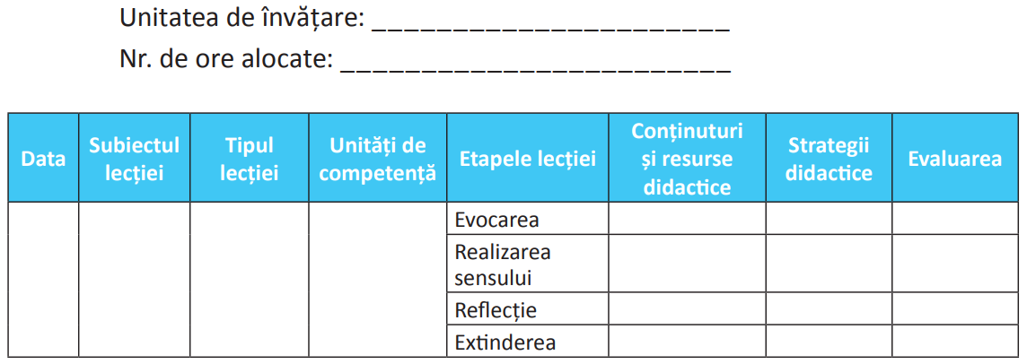
PROIECTAREA PE UNITĂŢI DE ÎNVĂŢARE

Slide 7
Planning Based on Learning Units (Proiectarea pe unităţi de învăţare)
It is carried out in accordance with the provisions of the Implementation Guides for the Curriculum based on the Curriculum for Foreign Languages.
It is an open and flexible structure of the educational approach.
It is unified thematically.
It is supported by the school textbook and auxiliary teaching materials at the choice of the teaching staff.
GHID de implementare a curriculumului, p. 18-19, 26-27

Slide 8
Planning Based on Learning Units
Identifying the units of competence
Selecting the contents
Analyzing the teaching resources
Determining the teaching strategies and learning activities
Deciding the assessments tools
GHID de implementare a curriculumului, p. 18-19, 26-27

Slide 9
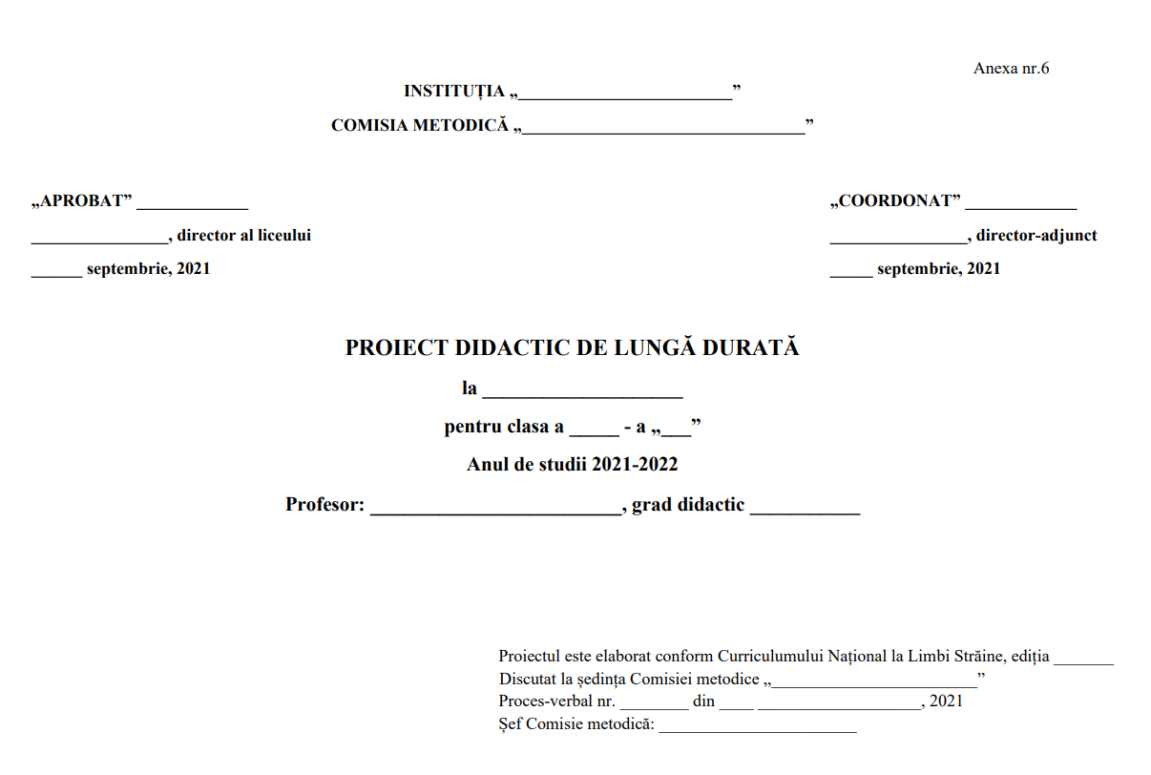

Slide 11
PROIECTUL DE ADMINISTRARE A DISCIPLINEI __________________

Slide 12
! “Linguistic competence”, “Pragmatic competence” and “Sociolinguistic competence” are always intertwined in any language use; they are not separate “components” and cannot be isolated from each other.

Slide 13
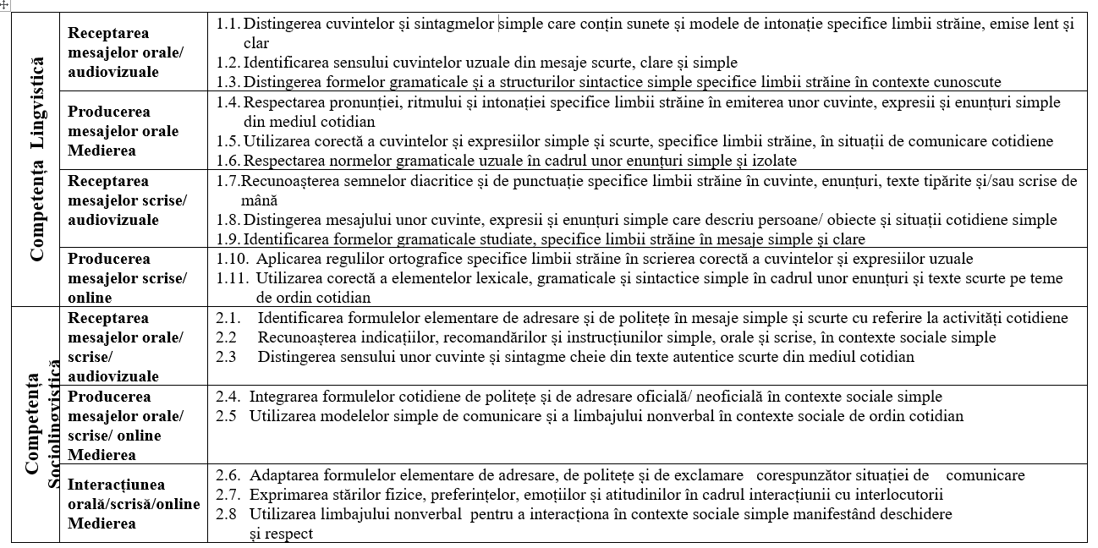

Slide 14
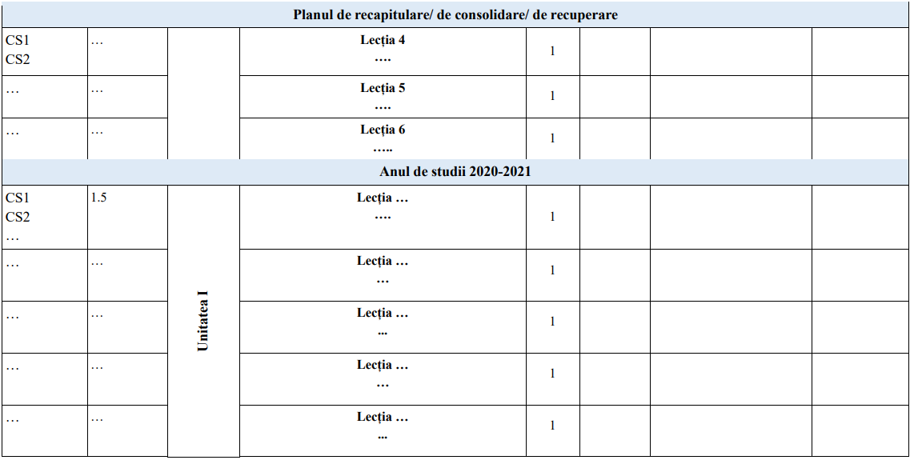

Slide 16
What is a lesson plan
A teacher’s detailed description of the course of instruction for an individual lesson.
A lesson plan is a written guide for trainers in order to achieve the intended learning outcomes. It provides specific definition and direction on learning objectives, equipment, instructional media, material requirements, and conduct of the training.
-- Education Dictionaries

Slide 17
Lesson Planning (Proiectarea didactică zilnică)
- It is carried out based on a procedural algorithm that correlates :
Lesson planning
Lesson Objectives (obiectivele operaţionale)
Contents
Materials/ Equipment (resursele)
Strategies
Assessment tools (instrumentele de evaluare)

Slide 18
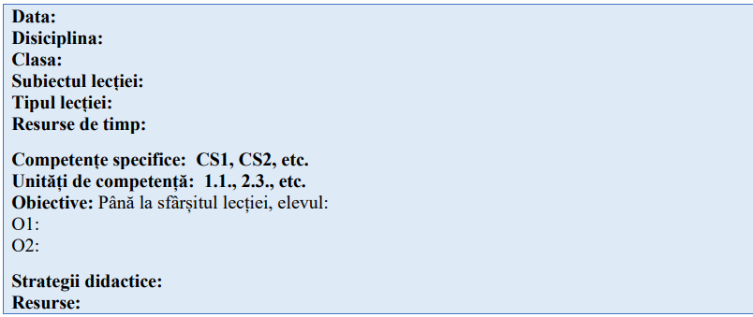
MODEL DE ANTET AL PROIECTULUI ZILNIC

Slide 19
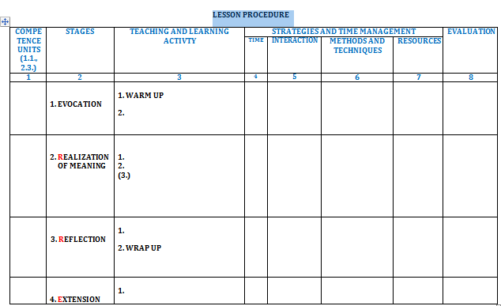

Slide 21
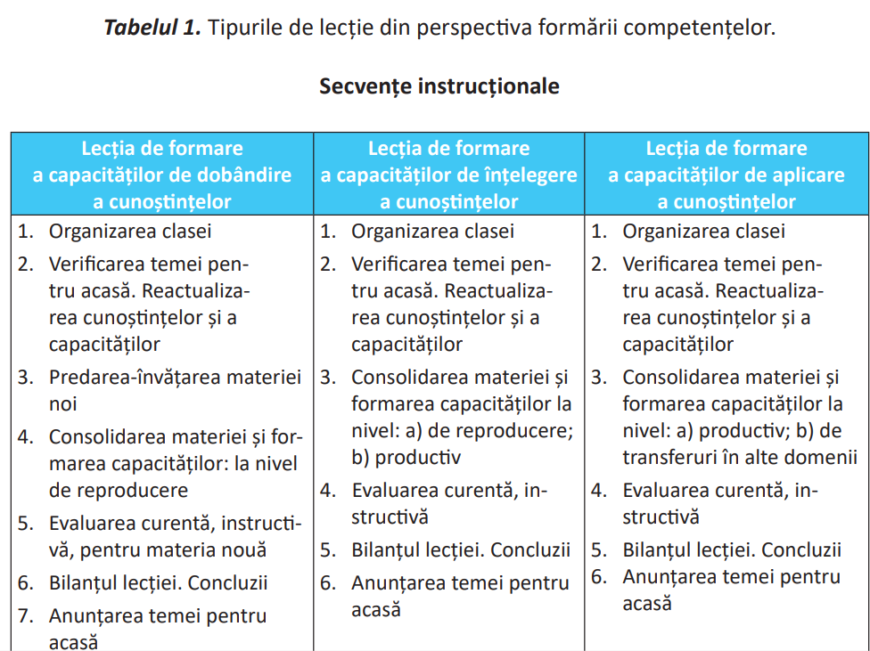

Slide 22
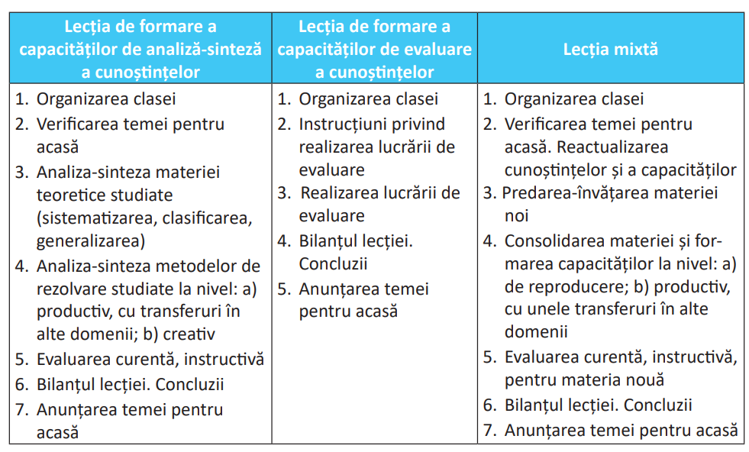

Slide 23
Formulating Lesson Objectives
A well-written learning objective provides a clear picture of the performance you expect as a result of the lesson. The learning objectives should be S.M.A.R.T.:
Specific – be precise about what you are going to do
Measurable –you will know when you have reached your goal
Achievable – Do not attempt too much. A less ambitious but completed objective is better than an over-ambitious one that you cannot possible achieve.
Realistic – do you have the necessary resources to achieve the objective?
Time constrained – determine when each stage needs to be completed.
Use strong positive statements with strong verbs. Avoid weak verbs.
Strong verbs: present, review, define, collect, construct, classify, develop, devise, produce, revise, select, synthesize, compare.
Weak verbs: appreciate, consider, enquire, learn, know, understand, be aware of, appreciate, listen, perceive.

Slide 24
Formulating Lesson Objectives
Robert Mager’s ABCD model for learning objectives includes four elements: audience, behavior, condition, and degree of mastery needed:
Audience (A) – Who? Who are your learners?
Behavior (B) – What? What do you expect them to be able to do? This should be an overt, observable behavior, even if the actual behavior is covert or mental in nature (Measurable verbs, Bloom’s Taxonomy).
Condition (C) – How? Under what circumstances or context will the learning occur? What will the student be given or already be expected to know to accomplish the learning?
Degree (D) – How much? How much will be accomplished, how well will the behavior need to be performed, and to what level?
"C: Given a sentence written in the present simple tense, A: the student B: will be able to rewrite D: correctly the sentence in the future simple tense.

Slide 25
Comment the following examples of objectives:
Students will talk about leisure activities using do, play and go, the present simple and adverbs of frequency;
Students will use correctly the present perfect and the past simple to discuss past experiences.
Having listened to a recorded dialogue, students will identify phrases used to describe food and use them in a discussion about restaurants and food preferences.
Students will formulate 2 arguments in favor of a facility that they think would benefit their school the most.
Students will exchange information about holiday jobs using indirect questions.

Slide 26
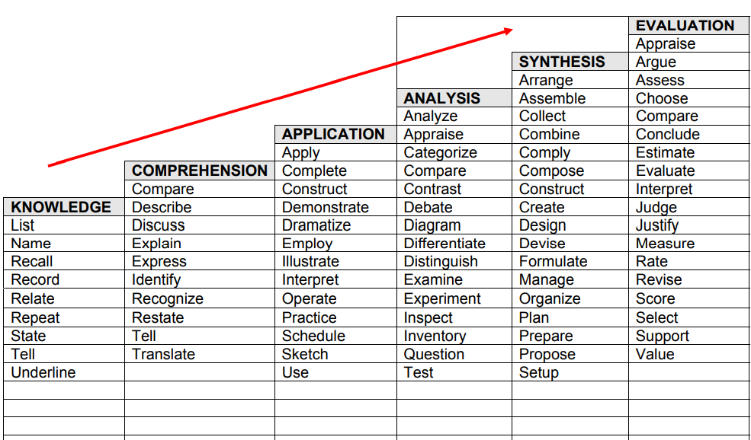
Bloom’s Taxonomy of Measurable Verbs

Slide 27
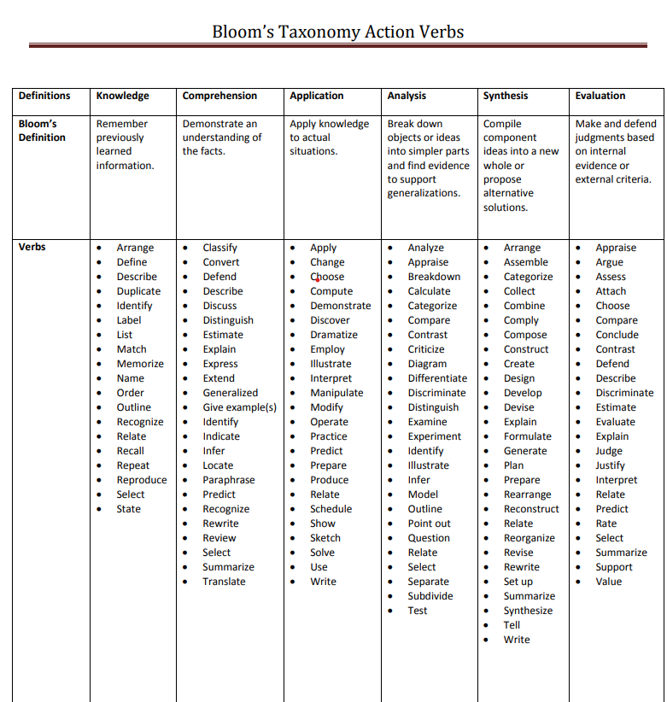

Slide 28
Gagne’s Nine Events of Instruction
Gain attention
Inform learners of objectives
Stimulate recall of prior learning
Present the stimulus
Provide “learning guidance”
Elicit performance (practice)
Provide feedback
Assess performance
Enhance retention and transfer.

Slide 29
Ensure the learners are ready to learn and participate in activities by presenting a stimulus to capture their attention.
Stimulate students with novelty, uncertainty, and surprise/unusual
Pose thought-provoking questions to students
Have students pose questions to be answered by other students./
Use brainstorming and discussion activities.
Give a short test.
1
2
Inform students of the objectives or outcomes for the course and individual lessons to help them understand what they are expected to learn and do.
Help students make sense of new information by relating it to something they already know or something they have already experienced.
Ask questions about previous experiences
Ask students about their understanding of previous concepts
Relate previous course information to the current topic
Have students incorporate prior learning into current activities
3

Slide 30
The following are ways to present and cue lesson content:
Present multiple versions of the same content (e.g. video, demonstration, lecture, group work, etc.)
Use a variety of media to engage students in learning
Incorporate active learning strategies to keep students involved.
4
The following are examples of methods for providing learning guidance:
Provide instructional support as needed – i.e. scaffolding that can be removed slowly as the student learns and masters the task or content
Model varied learning strategies – e.g. mnemonics, concept mapping, visualizing
Provide visual images, analogies, and metaphors.
5
6
Have students apply what they have learned to reinforce new skills and knowledge and to confirm correct understanding of course concepts.
7
Provide timely feedback of students’ performance to assess and facilitate learning and to allow students to identify gaps in understanding.

Slide 31
Assess the attainment of the objectives by employing methods such as pre- and post-tests, formative assessments, and diverse evaluation approaches, including the use of well-defined rubrics for written assignments, projects, or presentations.
8
Help learners retain more information by providing them opportunities to connect concepts to potential real-world applications.
Associate course concepts with prior (and future) concepts and build upon prior (and preview future) learning to reinforce connections.
Have students convert information learned in one format into another format (e.g. verbal or visuospatial, e.g. requiring students to create a concept map to represent connections between ideas).
9

Slide 32
Sequencing (communicative language teaching)
Lessons often begin with accuracy-based activities and move toward fluency-based activities.
Reading lessons often follow a format consisting of pre-reading, while-reading, and post-reading activities.
Listening lessons follow a similar format.
Conversation lessons often begin with controlled practice activities, such as dialogue practice, and move toward open-ended activities, such as role-plays.

Slide 33
Types of Lesson Sequences - ERRE Framework
Evocation (E)
Sts. are encouraged to use their knowledge and experience on a particular subject and to anticipate and determine the purpose of teaching and learning.
Sts connect the previously acquired knowledge with knowledge that is being acquired, thus enabling the transfer of knowledge.
Activating students’ schemata - the process of activating the sts’ prior knowledge, a technique that can help to reduce the memory load. It allows them to tune in to the topic and helps them to develop their expectations of the input.
Brainstorming Opinions, ideas and facts
KWL charts Speed writing
Group writing Associations Warm-up discussions
Clustering Quotations
Free writing Quizzes Predictions using visuals, key words from the text

Slide 34
Types of Lesson Sequences - ERRE Framework
Realization of meaning (Rz)
Learners are expected to experience new content and integrate it into their own knowledge.
Gets the students through a thematic presentation or other form of presentation of new contents.
The information is acquired through reading a text, listening to a piece of discourse, clarification, guided discovery, etc...
Sts are fully involved in discovering the meaning of the content.
Sts are encouraged to analyze, compare, synthesize, generalize and monitor their own understanding (clarification /focus).

Slide 35
Demonstration
Guided discovery
Explanation
Elicitation
DARTs – directed activities related to texts:
Reconstruction activities:
Cloze
Sequencing/ordering
Diagram completion
Prediction activities
Analysis activities:
Text marking
Text construction
Diagram construction
Table construction
Questioning
Summarizing
KWL table
Intensive reading

Slide 36
Types of Lesson Sequences - ERRE Framework
Reflection
The process of restructuring, i.e. practice activities aimed at integrating new information into old.
Sts think about what they have learned in the context of their existing knowledge, rearrange the existing knowledge, build a link between the existing and new knowledge and create a new quality.
Sts acquire new knowledge and develop new skills. This is possible only if students get actively involved in restructuring / rearranging existing knowledge so as to fit in new knowledge.
Sts express the new knowledge in their own words, bring the new knowledge in their personal contexts and get feedback from peers or teachers (controlled practice/restricted output).

Slide 37
Drills
Gap-fill task
Ordering tasks
Expansion tasks
Transformation tasks
Dialogues
Items on board
Chunks on cards
Memorizing scripts
Disappearing dialogue
Dialogue building
Communicative tasks
Information gap activity
Jigsaw activity
Guessing game
Task repetition
Milling activities
Storytelling based activities
Guess the lie
Insert the word
Chain story
Conversation and chat
Sentence star
True/false sentences
One of us /some of us
Concept mapping
Venn’s diagram

Slide 38
Types of Lesson Sequences - ERRE Framework
Extension (E)
The transfer of knowledge has occurred.
Teachers create contexts for students to try out real language, e.g. simulations, role-plays, advertisement design, debates and discussions, etc.
Sts solve authentic tasks (in a given set of circumstances, in a specific environment and within a particular field of action (Authentic output).
Role-play and simulations Writing a postcard
Personalization Writing a letter
Discussion and debates Presentations
Pyramid debate
Panel discussions

Slide 39
Types of Lesson Sequences – ESA Model
Engage
Study
Activate
Activities aimed at arousing the student’s interest: games, depending on the age and type, music, discussions, stimulating pictures, etc. Students may Engage with the topic before reading about it by being asked what they think about this topic, predicting the topic by looking at a picture of a person and saying what occupation the person has.
Activities focusing on language and how it is constructed, ranging from the study and practice of a single sound to an investigation of how a writer achieves a particular effect in a long text, etc. Students can study in a variety of different styles: the teacher can explain grammar, they can use the language evidence to discover grammar form themselves, they can work in groups studying a reading text or vocabulary. It is the stage at which the construction of language is the main focus, e.g. study and practice of paragraph organization.
Activities designed to use language freely and “communicatively”. The objective is not to focus on lge construction/practice specific bits of lge, but to use the lge which may be appropriate for a given situation or topic. Activate exercises offer students to try out real language, e.g. role-plays, writing a letter, a postcard, etc.

Slide 41
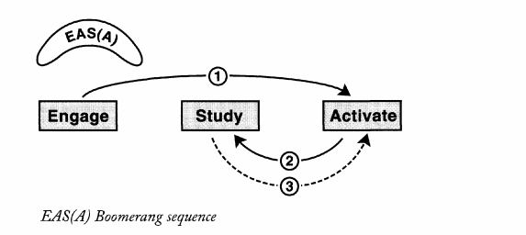
Variations of ESA Sequence
EASA correlates with the task-based learning TBLT

Slide 42
A SEQUENCE CONSISTING OF
Pre-task activities,
The task cycle,
The language focus,
and a Follow-up task.

Slide 43
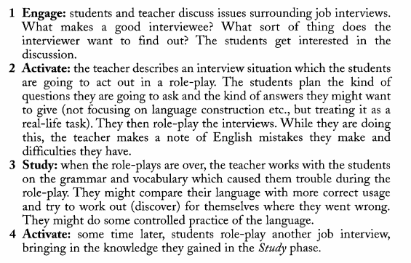
TBLT- Example

Slide 44
Sequencing (traditional language classes)
P–P–P:
Presentation (new language items are introduced),
Practice (students complete guided practice activities using the new language),
Production (students take part in freer, more open-ended activities using the new language).

Slide 45
Suggestion for the closing stage:
At the end of a lesson, it is usually valuable to summarize what the lesson has tried to achieve, to reinforce the points of the lesson, to suggest follow-up work as appropriate, and to prepare students for what will follow.
It is always important to praise the students for their effort and performance.
During the closing stage, students may raise issues or problems that they would like to discuss or resolve; at this time, you may also encourage them to ask you for suggestions concerning how they can improve.
_____________________________________________________________________
!!! Describe some effective ways of closing a lesson.

Slide 46
Motivation
It is also important to work toward maintaining the motivational level of the class. You can do this by asking yourself questions like the following:
Do I vary the way I teach my lessons?
Do I include activities that are there primarily to maintain motivation (e.g., songs and language games)?
Can I find ways of making my tasks more interesting (e.g., by presenting a reading text as a jigsaw reading)?
Can I increase the personal value of my lesson to my learners (e.g., by adapting an activity so that it centers on the students’ lives rather than on characters in the textbook)?
Can I build in more opportunities for success in my lessons (for example, by choosing activities that challenge but do not frustrate learners)?
Describe some ways in which you seek to develop a positive motivation toward language learning during your lessons.

Slide 47
References:
CURRICULUM NAȚIONAL, Învățământul primar, LIMBA STRĂINĂ I. Curriculumul disciplinar, Ghidul de implementare a curriculumului disciplinar, Chișinău, 2018, online https://mecc.gov.md/sites/default/files/curriculum_limba_straina_primar_tipar.pdf?fbclid=IwAR2znxT0x-deshMWRk4pXS2pQ48X8B9tXpol48ahO9ZNV4okMCKqBiKH6tk
CURRICULUM NAȚIONAL, LIMBA STRĂINĂ, Clasele V-IX. Curriculum disciplinar. Ghid de implementare, Chişinău, 2020, online https://mecc.gov.md/sites/default/files/limba_straine_gimnaziu.pdf
CURRICULUM NAȚIONAL LIMBA STRĂINĂ Clasele X-XII. Curriculum disciplinar. Ghid de implementare, Chişinău, 2020, online https://mecc.gov.md/sites/default/files/limba_straine_liceu.pdf
REPERE METODOLOGICE PRIVIND ORGANIZAREA PROCESULUI EDUCAȚIONAL LA DISCIPLINA ȘCOLARĂ LIMBA STRĂINĂ ÎN ANUL DE STUDII 2023-2024 https://mecc.gov.md/sites/default/files/4_repere_metodologice_lstraina_2023-2024_final_poe_site.pdf
REPERELE METODOLOGICE PRIVIND ORGANIZAREA PROCESULUI ORGANIZAȚIONAL LA DISCIPLINA ȘCOLARĂ LIMBA STRĂINĂ ÎN ANUL DE STUDII 2021-2022 https://mecc.gov.md/sites/default/files/7_repere_metod._2021_limba_straina_final.pdf
https://mec.gov.md/ro/content/proiecte-didactice-de-lunga-durata
Ministerul Educației și Cercetării | Guvernul Republicii Moldova

