Slide 1
Teaching Vocabulary. Introduction
Oxana Creanga

Slide 2
Vocabulary vs Lexis
Vocabulary typically refers mainly to:
single words (e.g. dog, green, wash)
sometimes to very tightly linked two- or three-word combinations (e.g. stock market, compact disc, sky blue, go off).
The concept of lexis is bigger. It refers to:
words
complete 'ready-made' fixed / semi-fixed/typical combinations of words that we can recall and use without having to construct new phrases and sentences word by word from scratch using our knowledge of grammar.

Slide 3
Lexis includes:
Fixed expressions, consisting of several words, which are used and learnt as wholes.
sentential formulae, including:
direct exponents of language functions such as greetings, e.g. How do you do? Good morning! Etc.
proverbs, etc.
• phrasal idioms:
semantically opaque, frozen metaphors, e.g.: He kicked the bucket (i.e. he died). It’s a long shot (= unlikely to succeed). He drove hell for leather (i.e. very fast).
intensifiers. Their use is often contextually and stylistically restricted, e.g. as white as snow (= ‘pure’), as against as white as a sheet (= ‘pallid’).

Slide 4
Lexis includes:
fixed frames, learnt and used as unanalyzed wholes, into which words or phrases are inserted to form meaningful sentences, e.g.: Please may I have…
other fixed phrases, such as:
phrasal verbs, e.g. to put up with, to make do (with) (manage with the limited or inadequate means available);
compound prepositions, e.g. in front of.
fixed collocations, consisting of words regularly used together, e.g. to make a speech/mistake, blonde hair, traffic jam.
b) Single word forms
may have several distinct meanings (polysemy), e.g. tank, a liquid container or an armored armed vehicle.
include members of the open word classes: noun, verb, adjective, adverb,
may include closed lexical sets (e.g. days of the week, months of the year, weights and measures, etc.).

Slide 5
Learning Burden
The learning burden of a word is the amount of effort required to learn it.
Different words have different learning burdens for learners with different language backgrounds.
Each of the aspects of what it means to know a word can contribute to the learning burden of a word.
The general principle of learning burden (Nation, 1990) is that the more a word represents patterns and knowledge that the learners are already familiar with, the lighter its learning burden. These patterns and knowledge can be from:
the first language,
from knowledge of other languages,
from previous knowledge of the second/foreign language.

Slide 6
Learning Burden
If a word:
uses sounds that are in the first language,
follows regular spelling patterns,
is a loan word in the first language with roughly the same meaning,
fits into roughly similar grammatical patterns as in the first language with similar collocations and constraints, then the learning burden will be very light (= the word will not be difficult to learn).

Slide 7
The learning burden will be heavy
For learners whose first language is not related to the second/foreign language, the learning burden will be heavy.
The learning burden of most words will be light
For learners whose first language is closely related to the second/foreign language, the learning burden of most words will be light.

Slide 8
Learning Burden
Teachers can help reduce the learning burden of words by:
drawing attention to systematic patterns and analogies within the second/foreign language,
by pointing out connections between the second/foreign language and the first language (L1).
Teachers should be able to estimate the learning burden of words for each of the aspects of what is involved in knowing a word, so that they can direct their teaching towards aspects that will need attention and towards aspects that will reveal underlying patterns so that later learning is easier.

Slide 9
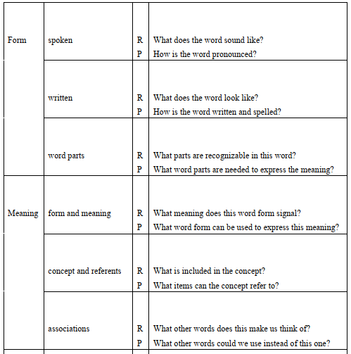
WHAT IS INVOLVED IN KNOWING A WORD
In column 3, R = receptive knowledge, P = productive knowledge.

Slide 10
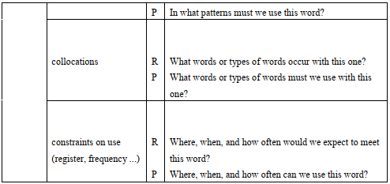
WHAT IS INVOLVED IN KNOWING A WORD

Slide 11
WHAT IS INVOLVED IN KNOWING A WORD. Example:
From the point of view of receptive knowledge and use, knowing the word underdeveloped involves:
being able to recognize the word when it is heard
being familiar with its written form so that it is recognized when it is met in reading
recognizing that it is made up of the parts under-, -develop- and -ed and being able to relate these parts to its meaning
knowing that underdeveloped signals a particular meaning
knowing what the word means in the particular context in which it has just occurred
knowing the concept behind the word which will allow understanding in a variety of contexts
knowing that there are related words like overdeveloped, backward and challenged
being able to recognize that underdeveloped has been used correctly in the sentence in which occurs
being able to recognize that words such as territories and areas are typical collocations
knowing that underdeveloped is not an uncommon word and is not a pejorative word.

Slide 12
WHAT IS INVOLVED IN KNOWING A WORD. Example
From the point of view of productive knowledge and use, knowing the word underdeveloped involves:
being able to say it with correct pronunciation including stress
being able to write it with correct spelling
being able to construct it using the right word parts in their appropriate forms
being able to produce the word to express the meaning "underdeveloped“
being able to produce the word in different contexts to express the range of meanings of underdeveloped
being able to produce synonyms and opposites for underdeveloped
being able to use the word correctly in an original sentence
being able to produce words that commonly occur with it
being able to decide to use or not use the word to suit the degree of formality of the situation (At present developing is more acceptable than underdeveloped which carries a slightly negative meaning)

Slide 13
How is vocabulary learned?
“The mind seems to store words neither randomly nor in the form of a list, but in a highly organized and interconnected fashion …called the mental lexicon.” (Thornbury, p. 16)
Knowledge of a word is acquired through the following processes:
Labeling – mapping words onto concepts (name dog & the concept dog)
Categorization/categorizing (toy dog, pictures of dogs, other people’s dogs)
Network building – connecting words to superordinate terms (cat-animal; apple-fruit) below / bellow

Slide 14
The learner's vocabulary size
20.000 words (word families) – an educated native speaker
1000 words (word families) – added every year
5000 words – acquired by the age of five
5000 words – acquired by the foreign language learner after several years of study.
2000 words – the core vocabulary; the size of the defining vocabulary used in the dictionaries for language learners (words and suffixes used in dictionary’s definitions). Knowledge of this lexicon provides familiarity with nearly 9 out of 10 words in most written texts.(50 words a week in 40 weeks=1 academic year)
100 most frequent words – grammar/function words (has, to did, she, to, were), not content words – make up at least 50% of most texts
https://my.vocabularysize.com/select/test
https://www.lextutor.ca/tests/levels/productive/
3000 word families – a basic vocabulary recommended by most researches
Over 5000 word families of active vocabulary – for more specialized needs, the same size for students who intend to pass the Cambridge First Certificate Examination
The specialized academic word list (570 word families) – for students preparing for academic study. That are not in the most frequent 2,000 words of English but occur reasonably frequently over a very wide range of academic texts. Therefore, the words in the academic vocabulary are useful for learners studying humanities, science or commerce.

Slide 15
Principles ensuring vocabulary acquisition
In order to insure that material moves into permanent long-term memory, a number of principles need to be observed:
Repetition – repeated rehearsal vs. rote learning, e.g. repetition of encounters with a word. When reading, words have a good chance of being remembered if they have been met at least 7 times over spaced intervals. (articulatory loop)
Retrieval – retrieval practice effect (another type of repetition), e.g. using the new word in written sentences prepare the path for future recall.
Spacing – distributed practice, i.e. involves spreading the repetitions across a long period of time, but not spending more time in total on the study of the words.

Slide 16
Principles ensuring vocabulary acquisition
Pacing – students should be given the opportunity to pace their own rehearsal activities, i.e. allowing time during vocabulary learning for students to do memory work – organizing and reviewing their vocabulary silently and individually.
Use – using words in different activities/practice.
Cognitive depth – the more decisions the learner makes about the word (and the more cognitively demanding these decisions are) the better the word is remembered, e.g. deciding on the part of speech, using it to complete a sentence, etc.
Personal organizing – personal judgements of the word, i.e. reading aloud a sentence that contains the word showed better recall. (Making up their own sentences and reading them aloud did better still.)
Imaging – visualizing a mental picture to go with the new word; easily visualized words are more memorable than words that do not immediately evoke a picture.

Slide 17
Principles ensuring vocabulary acquisition
Mnemonics – tricks to help retrieve items or rules that are stored in memory and that are not yet automatically retrievable.
Motivation – willing to spend more time on rehearsal and practice pays off in terms of memory.
Attention/arousal – conscious attention is required to improve recall. Words that trigger a strong emotional response are more easily recalled than the ones that don’t.
Affective depth – the emotional associations attached to words. Affective information (emotional) is stored along with cognitive data and plays an important role on how words are stored and recalled. Making affective judgments about words is equally important as making cognitive judgments, e.g. Do I like the sound of the word? Does it evoke any pleasant or unpleasant associations?

Slide 18
Presentation
- pre-planned lesson stages in which learners are taught pre-selected vocabulary items.
Questions to consider:
The number of words to present. This will depend on the following factors:
the level of the learners
the learners' likely familiarity with the words
the difficulty of the items - whether, for example, they express is abstract rather than concrete meanings, or whether they are difficult to pronounce
their 'teachability' - whether, for example, they can be easily explained or demonstrated
whether items are being learned for production (in speaking and writing) or for recognition only (as in listening and reading). Since more time will be needed for the former, the number of items is likely to be fewer than if the aim is only recognition.
!Vocabulary presentation should include at most about a dozen items.

Slide 19
Presentation
Questions to consider:
2. The choice of the sequence of presentation:
meaning first, then form, or
form first, then meaning.
meaning first, then form:
E.g. hold up a picture of a shirt (the meaning), and then say It's a shirt (the form).
form first, then meaning:
E.g. say shirt a number of times, have the students repeat the word, and only then point to the picture.
Both approaches are valid.
Presenting the meaning first creates a need for the form, opening the appropriate mental 'files', and making the presentation both more efficient and more memorable.
‘Form first' presentation works best when the words are presented in some text so that the learners can work out the meaning for themselves.

Slide 20
Presentation
Questions to consider:
3. The means of presentation - whether to present the meaning through:
translation
real things (realia)
pictures illustrating the meaning
actions/gestures (demonstration)
definitions
situations explaining the meaning

Slide 21
Presentation
4. To present the word in its:
spoken form, or
written form
and in what order (e.g. spoken before written) and how soon (e.g. delaying the written form until the spoken form has been thoroughly learned)

Slide 22
Presentation
4. To present the word in its:
spoken form, or
written form
and in what order (e.g. spoken before written) and how soon (e.g. delaying the written form until the spoken form has been thoroughly learned)

Slide 23
Presentation
The means of presentation
translation is an economical way of presenting meaning but may not be the most memorable 'no pain, no gain.
Over-reliance on translation may mean that learners fail to develop an independent L2 lexicon, with the effect that they always access L2 words by means of their L1 equivalents, rather than directly.

Slide 24
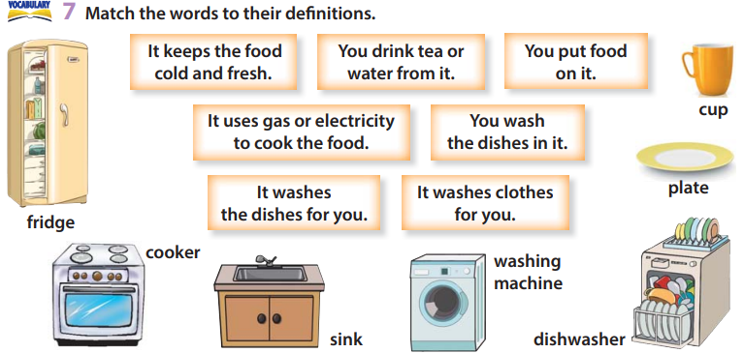
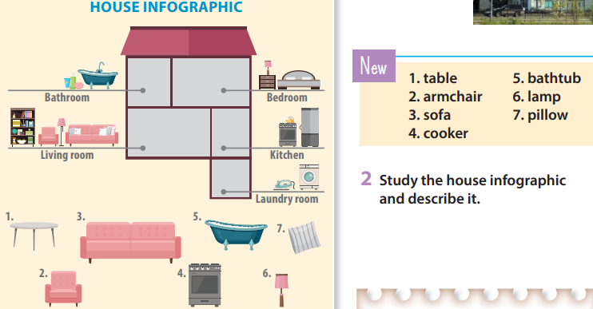
Presentation
The means of presentation
illustrating meaning (flashcards, wall charts, transparencies projected on to the board or wall using the overhead projector, and board drawings) is effective, but is limited to certain kinds of words.

Slide 25
Presentation
Non-visual verbal means of clarifying meaning include:
providing an example situation (situational presentation - providing a scenario which clearly contextualizes the target word/words)
giving several example sentences
giving synonyms ('fancy' - it means 'like'), antonyms ('outgoing' - it's the opposite of 'shy’), or superordinate terms (a 'herring' is a kind of fish).
giving a full definition.
!Explaining meaning verbally is time-consuming but can be effective if explanations are kept clear and simple.
For incidental vocabulary work; useful when explaining words that come up in texts.

Slide 26
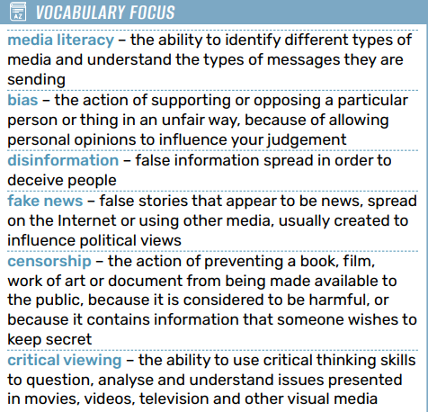
Layered definition
Situational presentation
Definitions
Example sentences

Slide 27
Presentation
Establishing the meaning of a new word first and then presenting its form is a standard approach.
The spoken form can be highlighted through the giving of clear models (listening drills, oral drills), the use of phonemic script, and repetition.
The written form should not be withheld too long.
Having established the meaning of a new word, the teacher can model it using listening drills (it is the teacher who does the repeating, so as to accustom the learners to the phonological features of the word).
Ita clear but natural enunciation of the word (or words), usually preceded by some sort of cue, such as 'Listen....'. This is repeated two or three times.
The modelling process can be accompanied by some visual stimulus, such as using the fingers of one hand to represent the different syllables (draw learners' attention to the syllable structure and stress of the word).
Get learners to vocalize the new words, after they have first subvocalized them (articulatory loop/mumble drill) by means of choral or individual repetition, i.e. drilling.

Slide 28
Presentation
Establishing the meaning of a new word first and then presenting its form is a standard approach.
The spoken form can be highlighted through the giving of clear models (listening drills, oral drills), the use of phonemic script, and repetition.
The written form should not be withheld too long.
Learners should be actively involved in the presentation.
Elicitation, e.g. the teacher to present the meaning of a word (e.g. by showing a picture) and asking learners to supply the form.
Personalization is simply the process of using the new word in a context that is real for the learner personally.

Slide 29
Practice - integration activities
Integrating New Knowledge
New words must be integrated into the learners' mental lexicon (the learners' existing network of word associations).
Deep decisions enhance integration and promote long-term retention.
Words need to be actively engaged in working memory through various operations:
taking apart and put back together again (dissecting the structure of a word, understanding its roots, prefixes, and suffixes, and then reconstructing it in the context of usage)
comparing
combining
matching
sorting
visualizing
re-shuffling (rearranging or reorganizing information, creating different associations)
being repeatedly filed away (categorizes and stores the new words in a systematic manner)
Recalling
Repeated recall strengthens memory for easier retrieval.

Slide 30
Practice
integration activities - the decision-making tasks
(Receptive - learners make judgements about words, but don't necessarily produce them)

Slide 31
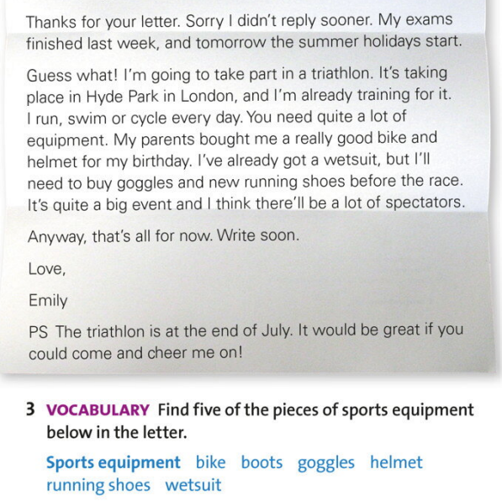
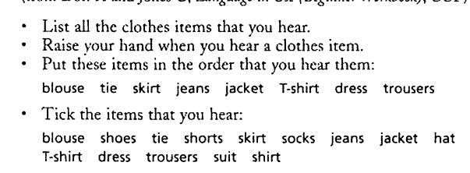
Decision-making tasks
Identification Activities - finding them in texts:
Count occurrences of "plane(s)" and "train(s)" in the text.
Find four words related to flying.
Locate five phrasal verbs in the text.
Underline words ending in -ing.
Unscramble anagrams.
Word soup.

Slide 32
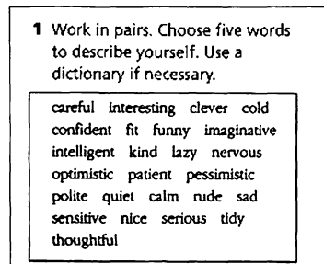
Decision-making tasks
Selecting tasks
cognitively more complex than identification tasks,
involve both recognizing words and making choices amongst them.
E.g. 'odd one out'

Slide 33
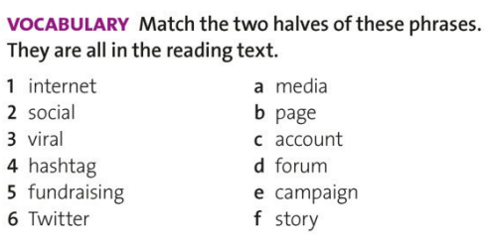
Decision-making tasks
Matching tasks
first recognizing words and then pairing them with:
a visual representation,
a translation,
a synonym,
an antonym,
a definition,
or a collocate.

Slide 34
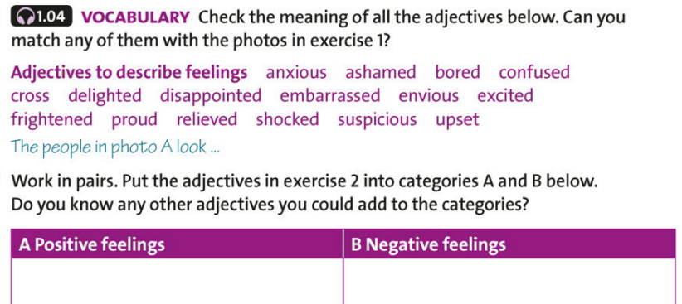
Decision-making tasks
Sorting activities
- Require learners to sort words into different categories.
- The categories can either be given, or guessed.

Slide 35
Production tasks
Learners are required to incorporate the newly studied words into some kind of speaking or writing activity:
completion of sentences and texts
creation of sentences and texts.

Slide 36
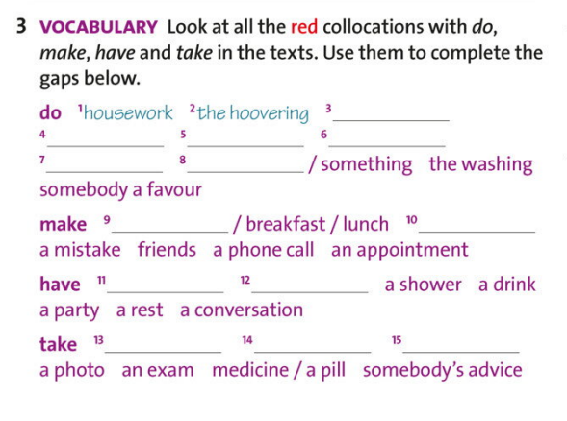
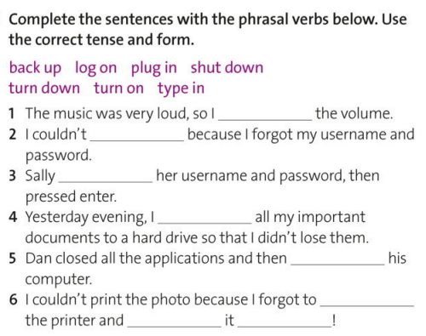
Production tasks
Completion Tasks
Sentence and text completion tasks, known as gap-fills.
open gap- fills (drawing from the mental lexicon)
closed gap- fills (provided word list).

Slide 37
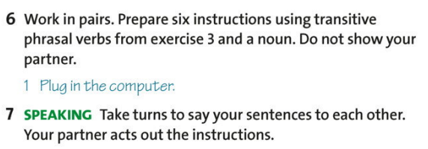
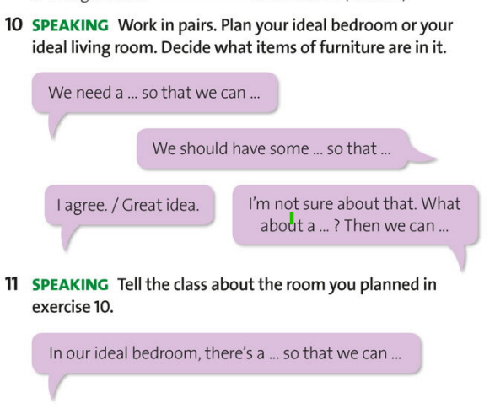
Production tasks
Sentence and Text Creation
Learners create contexts for given words.
Examples of task instructions:
Make a sentence showing the meaning of each word.
Write a true sentence about yourself or someone you know using the words.
Create a short narrative or dialogue including at least five words from the list.

Slide 38
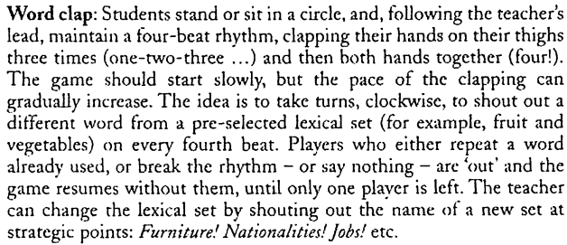
Vocabulary Games

Slide 39
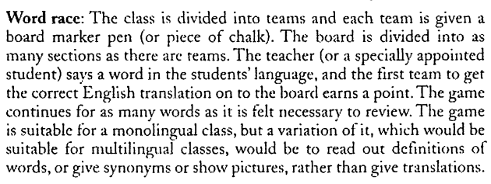
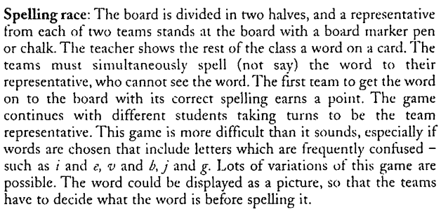
Vocabulary Games

Slide 40
The implications for teaching:
Help students with tasks and strategies to help them organize their mental lexicon by building networks of associations.
Encourage learners to avoid translation of vocabulary items in their L1.
Present words in their typical contexts to help sts acknowledge their meaning, register, collocations and syntactic environments.
Focus sts’ attention on to the sound of the new words (namely the stress).
Learners should aim to build a threshold vocabulary as quickly as possible.
Involve learners in the learning of new words. They need multiple exposures to words and they need to retrieve words from memory repeatedly.
When learning vocabulary, learners need to make multiple decisions about words.
Memory of new words can be reinforced if they are used to express personally relevant meanings.
Except strategies and tasks aimed at teaching new vocabulary, learners also need plentiful exposure to talk and text as well as training for self-directed learning.

Slide 41
Remembering lexical items – recording lexical items in useful ways:
Scrivener J. Learning Teaching. The Essential Guide to English Language Teaching. 3rd edition. Macmillan, 2014.
Pp. 198-205.

Slide 42
References:
Nation I.S.P. Learning Vocabulary in Another Language. Cambridge: Cambridge University Press, 2002. 772
Scrivener J. Learning Teaching. The Essential Guide to English Language Teaching. 3rd edition. Macmillan, 2014.
Thornbury S. How to Teach Vocabulary. Pearson Education Limited, 2002. 185.
Teaching Vocabulary to Young Learners Through Brain-Based Teaching Strategies by Setenay Çelik https://www.youtube.com/watch?v=pzIv02E9vU8&t=14s
20 Tips on Vocabulary Teaching with Penny Ur https:/ /www.youtube.com/watch?v=6BKQODyQAdU

