Slide 1
PHRASES AND CLAUSES
PhD DORINA MACOVEI

Slide 2
A phrase - a group of words functioning in a sentence as a single part of speech. It does not have a subject or a verb, so it cannot stand alone as an independent unit—it can function only as a part of speech.
A clause - a group of words with its own subject and verb. Like phrases, clauses enrich your written and oral expression by adding details and making your meaning more exact. Clauses also allow you to combine ideas to show their relationship. This adds logic and cohesion to your speech and writing.

Slide 4
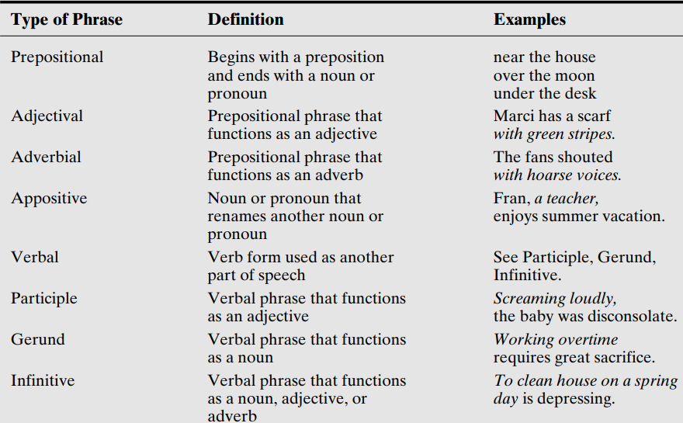

Slide 5
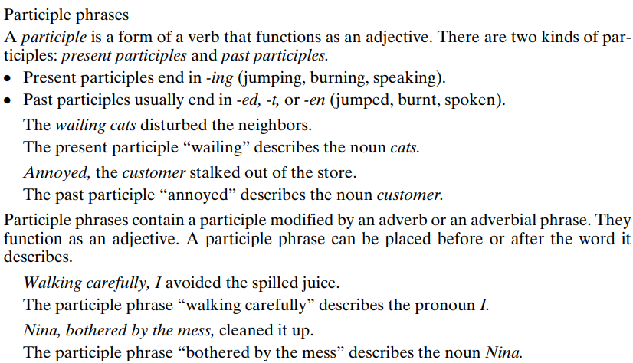

Slide 6
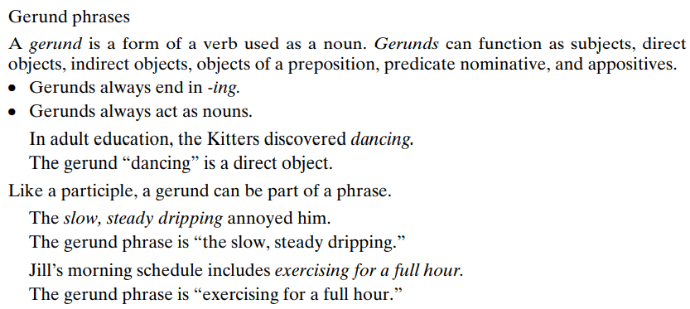

Slide 8
Find one or more sentences on the internet containing these phrases:

Slide 9
CLAUSES

Slide 10
Four different kinds of main clauses:
declaratives (statements)
interrogatives (questions)
imperatives (orders/instructions)
exclamatives (used for exclamations)
Three different kinds of subordinate clauses:
adverb clauses
adjective clauses
noun clauses

Slide 12
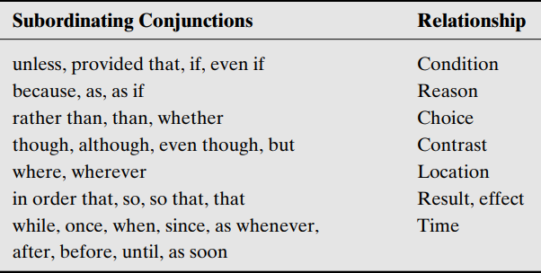

Slide 14
Four different kinds of main clauses:
declaratives (statements)
interrogatives (questions)
imperatives (orders/instructions)
exclamatives (used for exclamations)
Three different kinds of subordinate clauses:
adverb clauses
adjective clauses
noun clauses

Slide 15
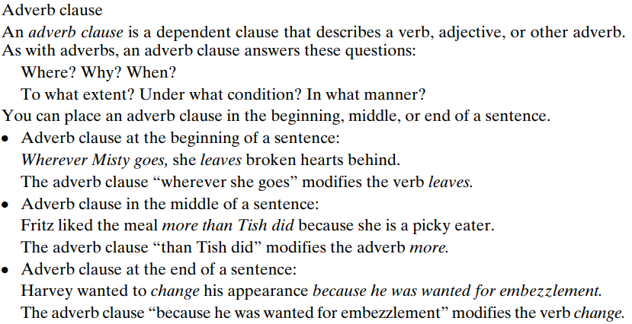

Slide 17
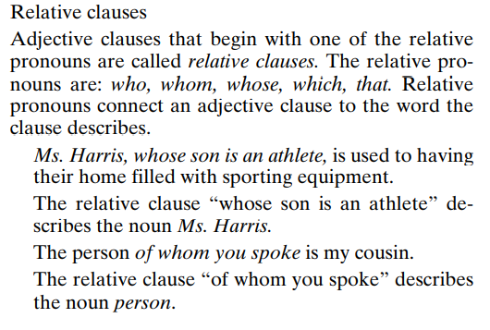

Slide 19
PRACTICUM (identify the clause type)
I’m looking for the red book that went missing last week.
Finn is asking for the shoes which used to belong to his dad.
You there, who is sitting quietly at the corner, come here and lead the class out.
I like what I hear.
You need to express that it’s crossing a line for you.
He knows how things work around here.
Alice did the dishes till her legs gave up.
Tina ran to the point of panting vehemently.
I went through the book at a lightning speed.

Slide 20
Adverb clauses.
You are an insurance company. You have to advertise 5 crazy insurance policies, each with a title and description beginning ‘in case’:

Slide 21
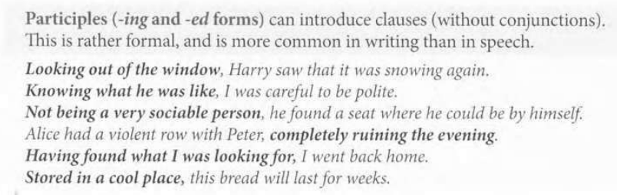
Participle clause = non-finite clause - They contain a Participle or an Infinitive Verb that makes the Subject and Verb evident even though hidden.

Slide 23
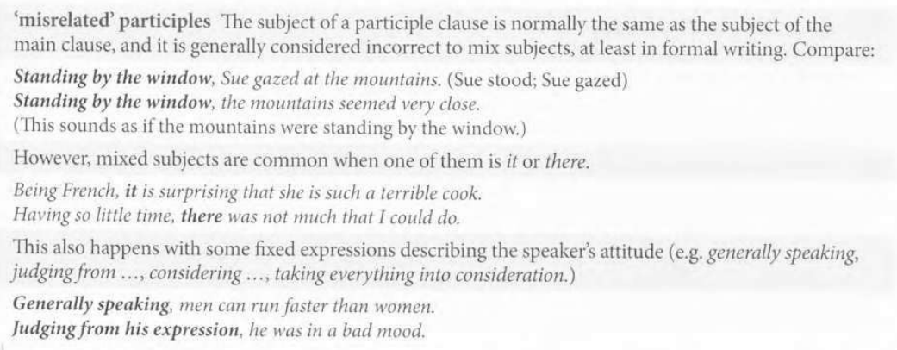

Slide 24
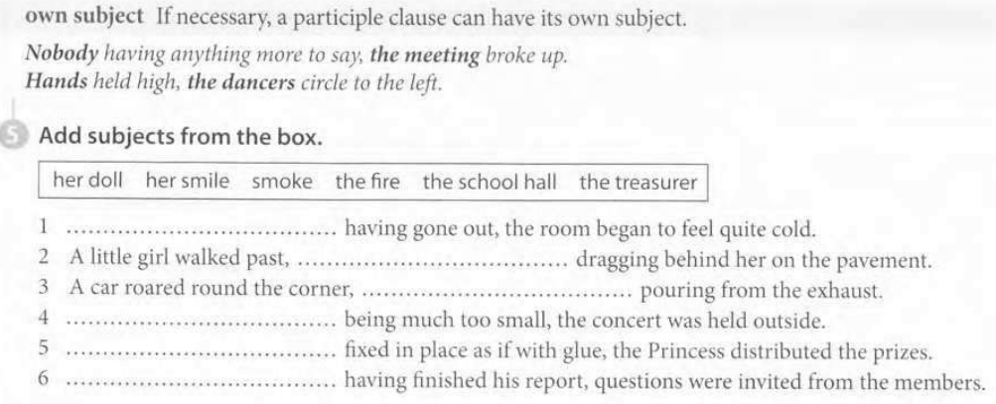

Slide 25
Question-word clauses

Slide 26
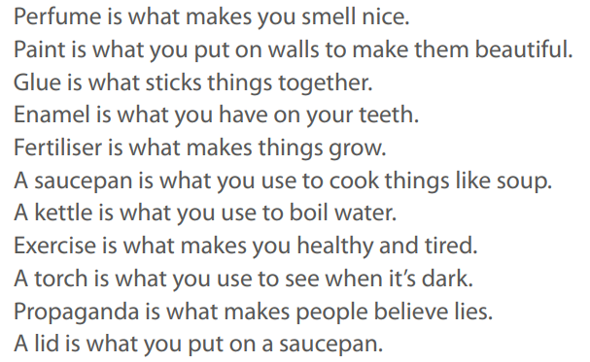
Continue the sentence using a noun clause

Slide 27
