Slide 1
Developing Listening Comprehension
Oxana Creanga, PhD, Associate Professor

Slide 2
Defining listening comprehension/ oral reception
Reception involves receiving and processing input: activating appropriate schemata in order to build up a representation of the meaning being expressed and a hypothesis as to the communicative intention behind it.
Incoming co-textual and contextual cues are checked to see if they “fit” the activated schema – or suggest that an alternative hypothesis is necessary.
In “oral reception”, the language user receives and processes live or recorded input produced by one or more other people.
CEFR Companion Volume, 2020, p. 47
(Linguistic) co-text - the language immediately surrounding the item in question which tells us its meaning.
(Extralinguistic) context - the social setting in which language occurs

Slide 3
Listen - WHY?
general information (for main points);
specific information (particular items);
cultural interest in general;
for people’s attitudes and opinions;
organization of ideas;
sequence of events;
for lexical items (words expressing noise, movement, etc.);
for function items, their form and use.
for pleasure;
for testing.

Slide 4
Listen - WHY?
We distinguish between 2 types of listening objectives:
Surface level comprehension;
recognizing information (main ideas, details, multiple choice)
recalling information (main ideas, details, wh-questions)
Higher Order Thinking Skills
recognizing information (summarizing, paraphrasing, classifying, comparing, contrasting)
inferring information (predicting, guessing)
evaluating information (judgments of importance, opinions)
appreciating information (emotional response).

Slide 5
Types of Listening we engage in on a day-to-day basis:
inferring.

Slide 6
TYPES OF CLASSROOM LISTENING PERFORMANCE
- that is what students do in a listening technique.
! Sometimes these types of performance are embedded in a broader technique or task, and sometimes they are the sum total of the activity of a technique.
Reactive: Listen and repeat (coral and individual drills). Little or no meaningful processing of the message.
Intensive: Listen to focus on components of discourse (phonemes, words, intonation, discourse markers, etc.).
Responsive: Listen to teacher prompt in order to give a short reply.
Selective: Listen to a passage for certain information.
people's names
dates
certain facts or events
location, situation, context, etc.
Extensive: Listen to a passage or a lecture for the main idea and general information. Might invoke note-taking, discussion.
Interactive: this type of performance can include all five of the above types as learners listen to participate in discussion, debate, role-play, etc. It is integrated with speaking.

Slide 7
What makes listening difficult?
Clustering
In spoken language we break down speech into smaller groups of words. In teaching listening you need to help students pick out manageable clusters of words. Do not ask them recall long sentences.
Redundancy
I mean, you know,...words which contribute nothing to the message, but make learners confused. One should learn to take advantage of redundancies as well as other markers that provide more processing time.
Reduced forms. (‘Djiityet?’ For ‘Did you eat yet?’)
Elision
The process when sounds are omitted, usually from the beginning or end of a word, in order to make pronunciation of the utterance easier for the speaker. She sat next to the wall. The t of next is elided into the t of to so that it becomes /nekstə /, but we know that she did not sit necks to the wall.
Assimilation
It takes place when the first of a series of sounds changes to accommodate subsequent sounds. For example, Tony’s a heart breaker. The t sound in heart changes to either a glottal stop or a p in this context: (/ha:pbreikə/), though Tony breaks girls’ hearts, not harps.

Slide 8
What makes listening difficult?
Intrusion
The process when a sound is added in order to allow the speaker to link two words more easily. For example, He doesn’t have an original idea in his head. Speakers of British English often add an intrusive r sound between idea and in (/aidiərin/); it sounds as though he doesn’t have an original ‘eye-deer’ in his head.
Performance variables (hesitations, false starts, pauses, corrections, etc. )
Colloquial language (idioms, slang, reduced forms)
Dialect differences
Rate of delivery
organization (do the speakers ramble on, jumping from topic to topic, or are they concise?),
duration,
number of speakers (the more speakers, the more difficult it is to follow the conversation), reciprocal/nonreciprocal listening.
Characteristics of the message
Linguistic difficulties: unknown words, lexical density (short spaces of time between content words, forcing the listener to concentrate harder), complex grammatical structures, etc.
Non-linguistic characteristics of the message: familiarity of the topic, text type and cultural accessibility.

Slide 9
What makes listening difficult?
Stress, rhythm, and intonation
Because English is a stress-timed language, English speech can be a terror for some learners as mouthfuls of syllables come spilling out between stress points.
E.g. the sentence "The PREsident is INTerested in eLIMinating the emBARgo," with four stressed syllables out of eighteen, theoretically takes about the same amount of time to utter as "Dead men wear plaid.
Intonation is significant not only for interpreting such straightforward elements as questions, statements, but more subtle messages like sarcasm, insult, praise...
Interaction
Conversation is especially subject to all the rules of interaction: negotiation, clarification, attending signals, turn-taking, and topic nomination, maintenance, and termination. Good listeners are good responders. One should be ready to give feedback, to ask for clarification, to maintain a topic.

Slide 10
Memory and listening
As we process one word, another word is ‘incoming’. The mind gets flooded with words. Unless we are well attuned to the rhythm and flow of the language, and the way in which a piece of discourse is likely to continue, this can lead to overload, which is one of the main reasons why students ‘switch off’.
Activating students’ schemata (ˈskiːmətə)
the process of activating the listener’s prior knowledge, a technique that can help to reduce the memory load. It allows them to tune in to the topic and helps them to develop their expectations of the input, a crucial factor in getting them to predict content.
E.g., going to the bank activates the following schemata: a person walks towards a brick building, pushes open a door made of wood and glass, and stands in a queue for half an hour.

Slide 11
Bottom-up versus top-down approaches to listening
Bottom-up
Emphasizes the decoding of the smallest units - phonemes and syllables – to lead towards meaning – phrase – clauses – sentences;
based on discrete units of language in the text;
depends more on the sounds heard.
Top-down
Emphasizes the use of background knowledge to predict content;
refers to world knowledge, knowledge of the speaker or context, etc;
much of the comprehension relies on what happens in the mind before the listening has even begun;
depends on the listener.
We use both processes simultaneously when we listen, a process known as the interactive model.

Slide 12
Background knowledge about…
The world
The topic
The genre
The whole text
Longer Sections of text
Sentences
Clauses/chunks
Words
The text
Sounds

Slide 13
Do the following represent use of top-down or bottom-up strategies?
Before we start listening, we can already predict some possible words and phrases that might be used because of our knowledge of lexical sets associated with the topic.
We listen carefully to a recording a number of times so that we can find a word we can't catch clearly.
When we don't clearly catch some of what people say, we hypothesize what we have missed and reinstate what we think was there, based on our knowledge of similar conversations.
We know the typical pattern some interactions follow (e.g. the typical sequence of exchanges when ordering a taxi on the phone), and this helps us to understand these when they are spoken.
Strategy 2 is bottom-up. Strategies 1, 3 and 4 are examples of top-down strategies.

Slide 14
Listening strategies
- conscious, deliberate behavior which enhances learning and allows the learner to use information more effectively:
cognitive strategies (immediate task-focused),
metacognitive strategies (long-term learning-related, e.g., listen regularly to a radio broadcast/podcast to improve sts’ listening),
socio-affective strategies (interaction and attitude-related, e.g. Check your answers with a partner).

Slide 15
Listening strategies
Effective listeners utilize a combination of these strategies, adapting them to specific tasks.
The teachability of strategies is crucial, especially in language learning contexts where students might not naturally transfer strategies from their native language to the target language.
To be teachable, students must recognize a problem, teachers must exemplify and demonstrate the strategy’s effectiveness, and the strategy should be repeatable for future problem-solving.
Many educational materials now incorporate strategies, often in the form of rubrics, to help students develop their listening skills, demonstrating the importance of strategic approaches in education.

Slide 16
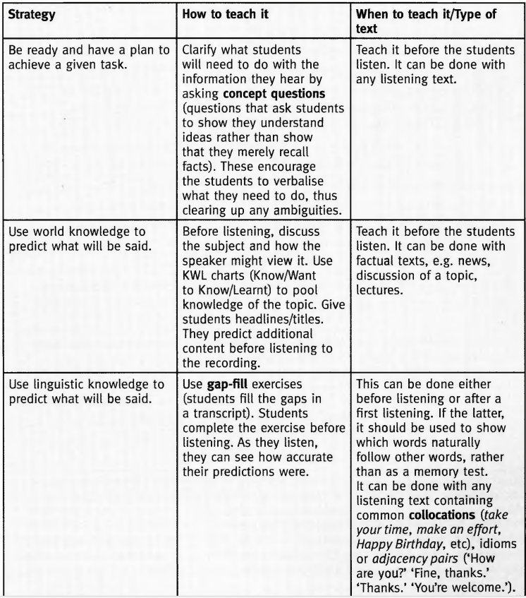

Slide 17
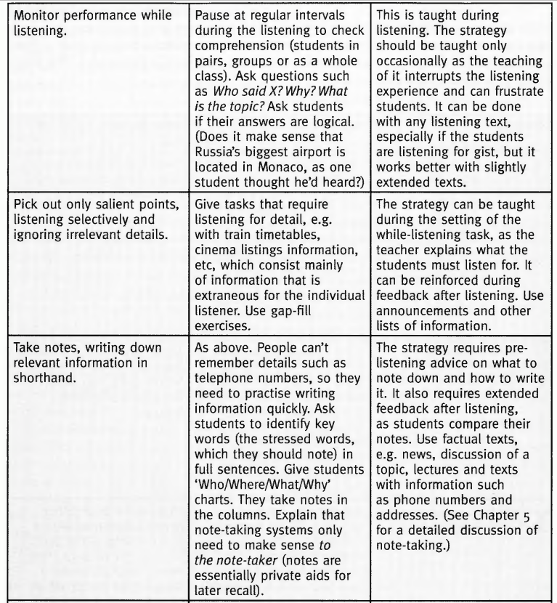

Slide 18
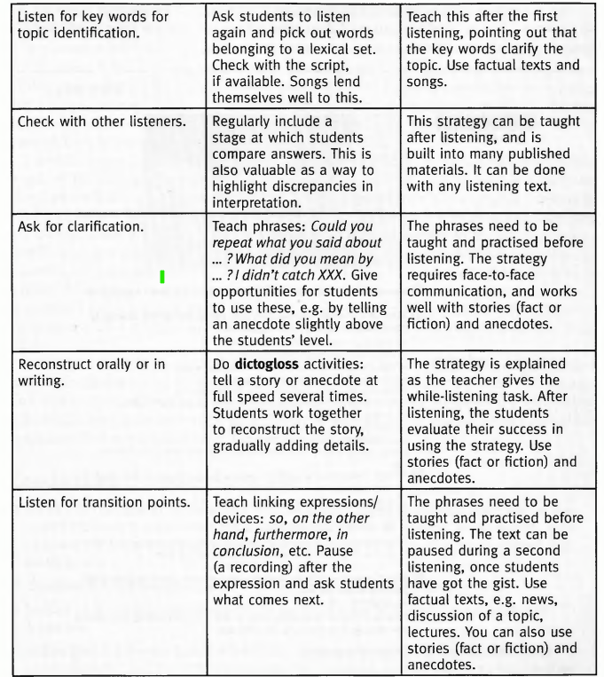

Slide 20
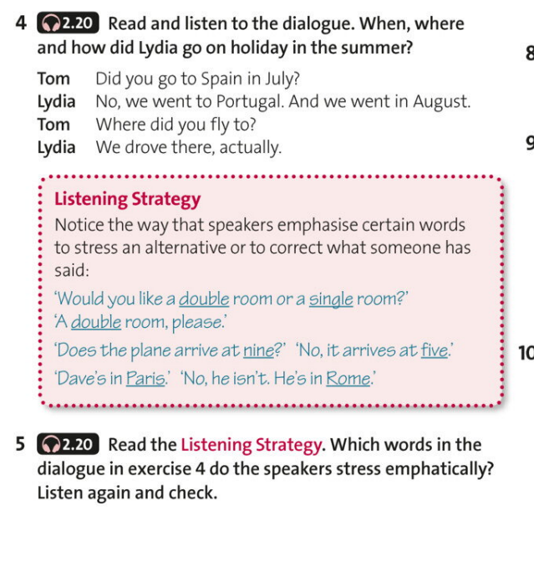

Slide 21
Listening in the lesson - the sequence
Pre-listening - helps students to prepare for what they going to listen:
The aims of stage are:
To activate the students' schema and vocabulary related to the topic;
To form some preliminary assumptions about the content of the text;
To motivate students for the activity by asking questions that could provide them with a reason for listening.
1. Activate schemata:
What do I know?
2. Reason:
Why listen?
3. Prediction:
What can I expect to hear?

Slide 22
The sequence: Pre-listening activities and techniques
Realia
Using photos
Guides, maps, brochures
Other objects
Texts and words
Gap-fill exercises
Key-words (The students use these words to predict what will happen in the text)
Opinions, ideas and facts
KWL charts
Speed writing
Quotations
Backgrounding
Quizzes
Advanced organizers (initial statements or questions about a topic, which the students read and discuss. One type of advanced organizer consists of ‘1 to 5’ statements. Students are given a list of statements based on a topic, and they say how much they agree on a scale of 1 to 5 (1 = completely disagree —► 5 = completely agree).
Reason to listen
Generating questions
Higher-order questions (which ask students to analyse something)
Lower-order questions (ask students for very basic factual information and usually have just one correct answer)
Guided discussions
Activating schemata
Brainstorming (Students generate ideas about the topic. The information can be organized within semantic maps/mind maps. )
From one to many
Poster display
Brainwalking
Board writing
Shout to scribe
Visuals
Pictures
Guess what’s happening
Picture story
Diagrams

Slide 23
Pre-teaching vocabulary
Importance of Pre-teaching:
Pre-teaching essential words enhances understanding and boosts students' confidence.
Decision to pre-teach should consider word importance, learner benefit, and time efficiency.
Effective Pre-teaching Strategies:
Teach in familiar context or encourage students to look up the word.
Ensure students grasp the concept, pronunciation, and use the word in sentences.
Recognition in connected speech is the goal; more student processing leads to better recognition.
Consideration for Number of Words:
Pre-teach fewer words; generally, more than 4-6 words may overwhelm students.
Memory, exposure to English, and word memorability influence the number of words to pre-teach.

Slide 24
Pre-teaching vocabulary
Challenges and Caveats:
Recent research questions the effectiveness of pre-teaching due to while-listening accessibility issues.
Focusing on pre-taught vocabulary may divert attention from the overall meaning of the passage.
Guessing unknown words is a valuable skill; encourages active learning.
Teacher's Role and Decision-making:
Teachers should carefully choose words for pre-teaching and assess if meaning can be inferred post-listening.
There are various pre-teaching activities; adapt approaches based on learning objectives and student needs.

Slide 25
Things to Avoid During the Pre-listening Stage
Avoid Lengthy Pre-listening Activities:
Pre-listening activities should be short and fast-paced to maintain student engagement and interest.
Avoid Overloading Students with Information:
Pre-listening is about introducing the topic, not providing all the answers.
Avoid Teacher-Centric Approaches:
Refrain from delivering a monologue or excessive teacher talk; encourage student participation.
‘Never say anything yourself if a student could say it for you.’
Christine Nuttall
Ensure Relevance to Listening Passage:
Focus the pre-listening discussion on the specific content of the listening passage. The pre-listening activity should directly relate to what students will hear, maintaining relevance and coherence.

Slide 26
The sequence: Importance of While-Listening Activities
Active Engagement with Listening Content:
Students must actively use the information they hear; the content should provoke thought and reactions.
Well-designed activities provide focus, highlight important aspects, reveal text structure, and aid concentration.
Tasks help students perceive and 'chunk' the listening into manageable sections, enhancing comprehension.
Enhancing Understanding through Tasks:
Activities help students understand the passage by showing what's important, structuring content, and providing clues for responses.
Tasks contribute to the entertainment factor by highlighting interesting aspects, humor, or irony.
Assessing Understanding:
While-listening tasks allow teachers to test students' understanding or confusion.
Evidence of understanding guides interventions, clarifications, and additional practice, ensuring effective learning outcomes.

Slide 27
The sequence: While-listening
Initial Listening for Gist:
Students listen to the passage once, focusing on the overall meaning or gist.
Here are some examples of typical gist questions:
What problem are they discussing?
What does the speaker think of the topic?
Look at the pictures.
Who are the speakers talking about?
Pair/Group Discussion:
Students check their answers in pairs or groups, fostering confidence and addressing doubts.
Second Listening:
Students listen a second time, either to verify their answers or respond to more detailed questions.
Important to assign different tasks during subsequent listenings, enhancing engagement and comprehension.
Debate on Listening Frequency:
Some argue for a single listening, mirroring real-life situations with limited chances.
Teaching context often involves multiple listenings, promoting comprehension and reinforcing learning.

Slide 28
Types of While-Listening Activities:
Recognition Responses
Involve identification and selection:
multiple-choice,
true/false questions,
ticking words and phrases, matching,
choosing pictures.
Less demanding, allowing more focus on comprehension.
Reduce distractions, leading to a clearer focus on the listening content.
Production responses
Involve active creation:
note-taking,
writing answers,
correcting errors,
completing tables, charts, diagrams, and sentences.
Require skills beyond listening: grammar, spelling, punctuation, and cohesive devices.
Potential drawbacks: pressure on short-term memory, distractions from the listening passage.

Slide 29
Types of While-Listening Activities:
Considerations for Activities:
Appropriate for different student levels.
Duration and balance: time spent listening vs. time spent responding.
Integration with other skills.
Degree of freedom in student responses: free vs. controlled.

Slide 30
While-Listening: Listening for the gist
On the first encounter with the listening text, students usually listen for gist - the main idea, the overall communicative intention of the speaker.
Understanding the gist provides context for analyzing themes, language, and pronunciation features.
Examples of typical gist questions:
What problem are they discussing?
What does the speaker think of the topic?
Look at the pictures. Who are the speakers talking about?
A simple gist exercise is to ask for basic information under the headings What? Who? Why?

Slide 31
While-Listening activities
Listen and do
Simon says
Last one is out (the students stand in a circle and follow the teacher’s commands. The last person to do so is out of the game.)
Stand up if...
Grab the word (choose about fifteen key words from the listening passage and write them on individual cards. Stick the cards on the wall or board, or if there are a lot of students, place the cards on the desks after making duplicate copies. The students listen as you read the passage or play the recording, and they grab the words when they hear them. The winner is the person who grabbed the largest number of cards.)
Mime
Just do it (create something physical while listening to instructions.)
Listening for detail/Selective listening
Bingo
Times, dates, numbers
Spot the difference
Mixed focus
Inferring
Pause and predict
Participating actively
Listen and describe
Interrupted storytelling
Truth or lie
Information transfer
Note-taking
Guided note-taking (provides students with structured prompts such as subheadings, numbers, and unfinished notes, aiding comprehension by indicating the listening passage's structure, transition points, and key points to focus on.)
Dictation
Dictogloss (the teacher reading the passage multiple times at full speed, with students taking notes. Subsequently, students collaborate in groups to reconstruct the passage in proper English, emphasizing grammar, link words, and sentence structure through discussion and collaboration. The activity concludes with groups comparing their version with the original text.)
Gapped dictation
False facts dictation
Grading dictation
Running dictation

Slide 33
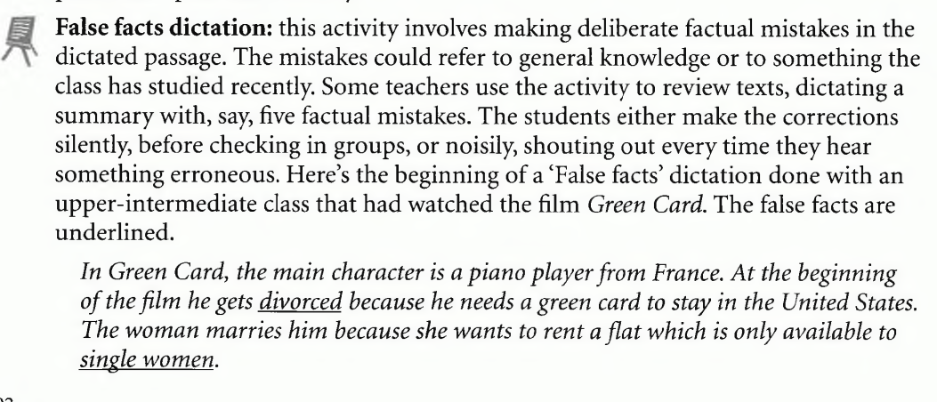

Slide 34
The sequence: Post-listening
During this stage whole class
checks answers,
discusses difficulties such as unknown vocabulary,
responds to the content of the passage, usually orally, sometimes in writing.
This may be done in
plenary (with the whole class)
in pairs
groups.
A final stage may involve the ‘mining’ of the recording for useful language, a particular grammatical structure, vocabulary or discourse markers, etc.

Slide 35
The sequence: Post-listening
Detailed Examination:
Post-listening activities involve analyzing both top-down features (setting, speaker information) and bottom-up features (individual words, phrases).
Focus on troubleshooting: Identifying breakdowns in communication and understanding the causes.
Troubleshooting Questions:
Did pronunciation differences like 'can' and 'can't' cause confusion?
Were unfamiliar words or unrecognized vocabulary like 'psychology' or 'knowledgeable' problematic?
Did rapid speech flow cause difficulties in segmenting words, leading to misunderstandings?
Were problems related to sentence structure, tenses, or specific grammar rules?
Did students lack knowledge about acronyms, names, or places mentioned in the passage?
Diagnostic Approach:
Classroom listening viewed as diagnostic, enabling teachers to pinpoint specific challenges.
Remedies offered: teaching strategies, exposure to varied vocabulary, grammar, and discourse markers, and consistent listening practice for improvement.

Slide 36
Post-listening activities
Checking and summarizing
Break it down (students summarize a listening passage in 50 words, their partner reduces it to 30 words, and the original writer further condenses it to 10 words, engaging in a multifaceted thinking process involving content hierarchy and word selection to enhance both writing and listening skills.)
Note comparison
Group summary
Discussions
Personalize (ask if the situation is the same for the students. How is it different? t ask what they would have done in the same situation, and why)
Questions
Statements (The students discuss whether they agree or disagree with a number of statements based on the listening passage. )
Sorting list (the teacher can list a number of aspects based on the topic and get the students to rank them in order of importance, desirability, cost, etc. Alternatively, depending on the text, the students discuss ‘dos’ and ‘don’ts’ based on the topic, and come up with their own list.)
Pros and cons
Creative responses
Genre transfer
Moral or headline
Hot seat
Illustrate
Critical responses
Information exchange
Jigsaw

Slide 37
Post-listening activities
Problem-solving
Sorting (Put... (the words/food types/people) into groups.)
Ranking (Example rubric: Say which is the best, the second best, the worst, etc. Ranking typically has no correct answer. Students need to justify their ideas, and the potential conflict may lead to good discussions.)
Ordering according to criteria (Example rubric: Say which is the heaviest, prettiest, most expensive, etc)
Solving moral dilemmas (What should they have done? What would you do?)
Deconstructing the listening text - to examine listening texts for their salient features - grammar, vocabulary, cohesive devices, discourse markers, pronunciation, etc.
Reconstructing the listening text
Gap-fill (Some words in the text are blanked out, and the student has to fill the gaps. This is a technique often used in testing, but it can be used for teaching, particularly if you blank out parts of idioms, prepositions or collocations (pairs or groups of words that are commonly found together, such as have breakfast, make a call, wide awake, sleep well) or adjacency pairs (e.g. A: How are you? B: Fine, thanks.’)
Disappearing dialogues
Reordering (Works particularly well with dialogues. The teacher cuts the script into strips. After they have heard the dialogue and done some while-listening activities, the students put the strips in the correct order. The activity is useful for highlighting the formulaic, predictable nature of functional exchanges, which contain features such as adjacency pairs.)

Slide 38
Order the stages of a possible route map of a listening lesson, starting from the 'big' background and overview tasks and moving towards the 'smaller', more detail-focused and language-focused issues.
a. More careful listening for complex meanings | By catching and interpreting smaller parts of the text, learners fine-tune their understanding.
b. Listening to pick out specific small language details | This focused work (e.g. on pronunciation) may raise learner awareness (e.g. of weak forms) and thus help students to listen better in future.
c. Predict the specific content | Students hypothesize specific issues that may be raised.
d. Discuss the general topic | Learners start to think about the topic, raising a number of issues that will be discussed later on the recording. This preparation may help them to hear these things being discussed later.
e. Predict the structure | Students consider / discuss possible organizational structures for a phone-in (who speaks? what kind of questions? typical exchanges?). This may help learners to recognize the content more easily.
f. Gist listening for attitudes | Learners interpret intonation, paralinguistic features (sighs, etc).
g. Gist listening for overview | Learners get an overall impression of the content without worrying about small items or individual words.

Slide 39
Possible route map for a listening lesson
Discuss the general topic | Learners start to think about the topic, raising a number of issues that will be discussed later on the recording. This preparation may help them to hear these things being discussed later.
Predict the specific content | Students hypothesize specific issues that may be raised.
Predict the structure | Students consider / discuss possible organizational structures for a phone-in (who speaks? what kind of questions? typical exchanges?). This may help learners to recognize the content more easily.
Gist listening for overview | Learners get an overall impression of the content without worrying about small items or individual words.
Gist listening for attitudes | Learners interpret intonation, paralinguistic features (sighs, etc).
More careful listening for complex meanings | By catching and interpreting smaller parts of the text, learners fine-tune their understanding.
Listening to pick out specific small language details | This focused work (eg on pronunciation) may raise learner awareness (eg of weak forms) and thus help students to listen better in future.

Slide 40
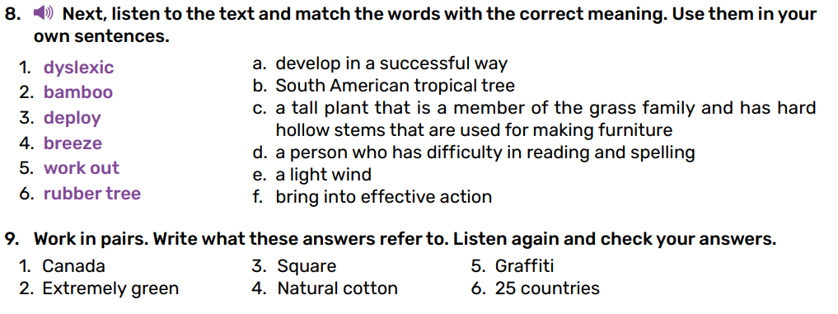
Analyze the listening sequence (English: Level A 2.4: Form 8 ):

Slide 41
Listening Activity Design
Criteria
The task should provide listening experience that prepares students for real-life listening situations(e.g. different kinds of natural English Speech):
The task should be practical to do in class (give the possibility to listen to the text more than once, ask students to respond in writing or action rather than speech).
So teachers need to compromise: maintain as much as they can of the naturalness of a listening task, while making sure that it has maximum teaching/learning value and is practical to administer in the classroom.
Listening Activity Design
Criteria
The task should provide listening experience that prepares students for real-life listening situations(e.g. different kinds of natural English Speech):
The task should be practical to do in class (give the possibility to listen to the text more than once, ask students to respond in writing or action rather than speech).
So teachers need to compromise: maintain as much as they can of the naturalness of a listening task, while making sure that it has maximum teaching/learning value and is practical to administer in the classroom.

Slide 42
Design features which can contribute to a successful listening task:
Expectations – students need in advance some idea about the kind of text they are going to hear (Listen to the passage vs. You are going to hear a husband and wife discussing their plans for the summer). The topic may be discussed with students in advance. This activates students’ previous knowledge and concepts of actions, scene, events, etc.
Purpose – set a task which leads to clear audible and visible or audible response. Instead of listen and understand, then answer the questions, it is better to give an instruction like Listen and find out where the family are going for their summer holidays. Mark the places on the map. This also enables them to listen selectively for significant information.
Selective listening – encourages students to listen out for what they need to know. This implies that they need to learn how to ignore irrelevant bits. Trying to understand every word is an ineffective listening strategy, doomed to failure. It may lead to students’ frustration and sense of failure in case they don’t understand anything early on the text.
Ongoing listener response – the task should usually involve intermittent responses during the listening. Students should be encouraged to respond to the info they are looking for as they hear it, not to wait to the end.
Interest – the task should be one that is interesting to do.

Slide 43
No tasks:
No pre-task might be provided if the text is easy and interesting to understand, e.g. anecdotes, jokes, fairytales, listening to a good poem, etc.
No preparation – students might be challenged to understand sth with no preparation whatsoever. The task here is to pick up clues to understand what type of text it is, and what it is about.
!Practical tips:
Don’t overload – don’t ask students to do too much. Even if the listening text is repeated, the initial feeling of failure should be avoided. The second listening is to provide extra listening experience, i.e. check and recheck their responses.
Don’t pre-teach too much vocabulary. Research shows that this is surprisingly unhelpful in getting students to understand the listening text. A first presentation of an unknown word doesn’t ensure that students would remember it. Students simply cannot recall the new items quickly enough to understand them as they occur in fast flowing speech.

Slide 44
References
Brown, H. D. Teaching by Principles: An Interactive Approach to Language Pedagogy. Longman, 2015.
Scrivener, J. Learning Teaching. The Essential Guide to English Language Teaching. 3rd edition. MACMILLAN
Ur, P. A Course in English Language Teaching. Cambridge: Cambridge University Press, 2012.
Wilson, J.J. How to Teach Listening. Pearson Education Limited 2008.
Moldovan Textbooks Read Aloud Virtual Library – America House Chisinau

