Slide 1
The National Curriculum for Foreign Languages
Oxana Creanga

Slide 2
Conceptual framework
The Foreign Languages Curriculum is an integral part of the National Curriculum, shaping education from primary to high school. It focuses on concepts, processes, products, and goals ensuring functional learning and development.
Incorporating the Latest Standards:
Grounded in the 2018 CEFR Complementary Volume, the curriculum emphasizes competence and content units, as well as recommended activities and products.
Communication and Personal Growth:
Teaching prioritizes the communicative aspect and action-oriented approach to the language in order to expand communication skills in a foreign language This approach not only enhances language proficiency but also fosters crucial attitudes for adolescent personality development.
Holistic Development:
The curriculum integrates new mandatory disciplines such as personal development, society education, and digital education. These activities go beyond linguistic skills, nurturing self-awareness. The aim is to empower students as informed, active citizens, capable of responsible decision-making and lifelong personal growth.

Slide 3
Innovative Approaches in the Foreign Language Curriculum
Clear Definition of Graduate Profile for each study cycle according to the new descriptors in the Complementary Volume, specifically A2+ for the middle/secondary school cycle.
Specification of the idea of competence and formulation of the new competences: linguistic competence, sociolinguistic competence, pragmatic competence and (pluri-/ inter-) cultural competence.
Introduction of the notion of units of competence replacing the notion of sub-competence.
Thematic Suggestions and Grammar Organization progressively across grades, tailored to each study cycle.
Introduction of a section dedicated to learning activities and recommended learning products.
Focus on Mediation Skills: introduction of elements related to fostering students' mediation skills.

Slide 4
Example of progressive organization of linguistic contents

Slide 5
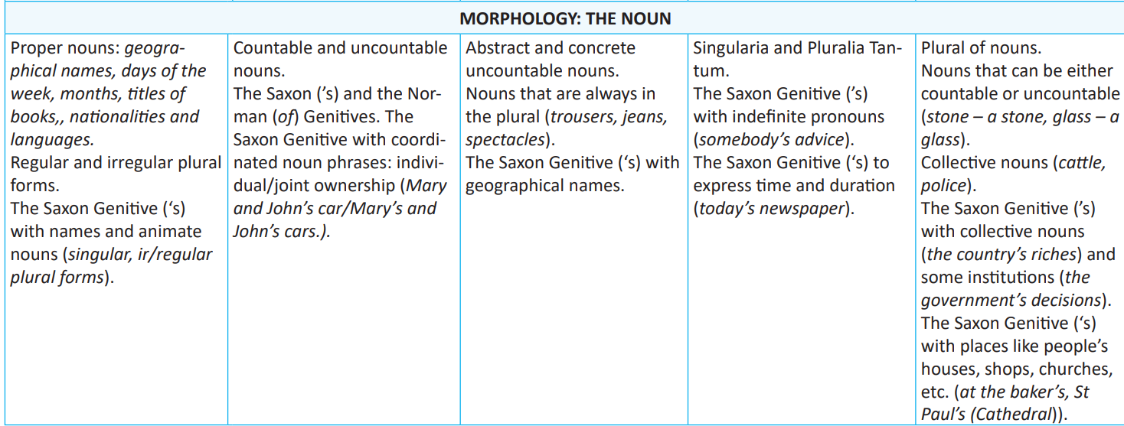
Example of progressive organization of linguistic contents

Slide 6
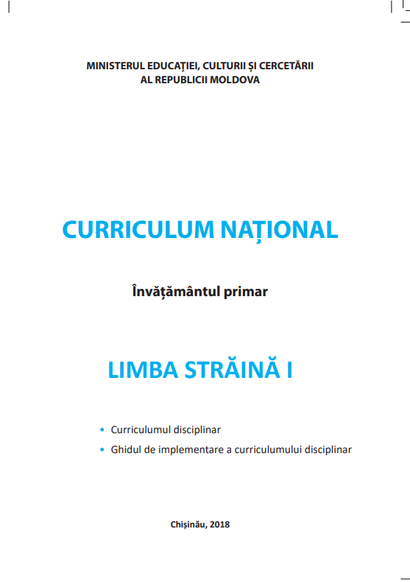
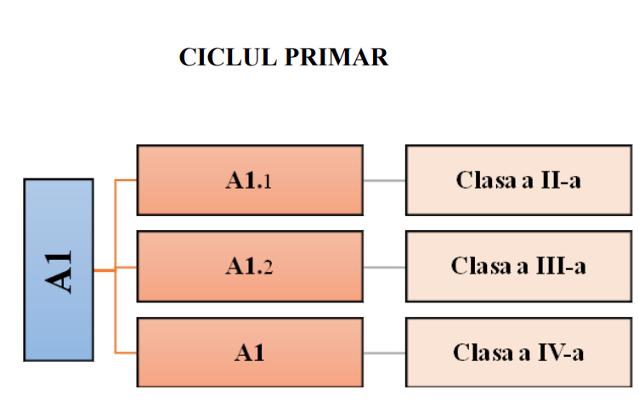

Slide 7
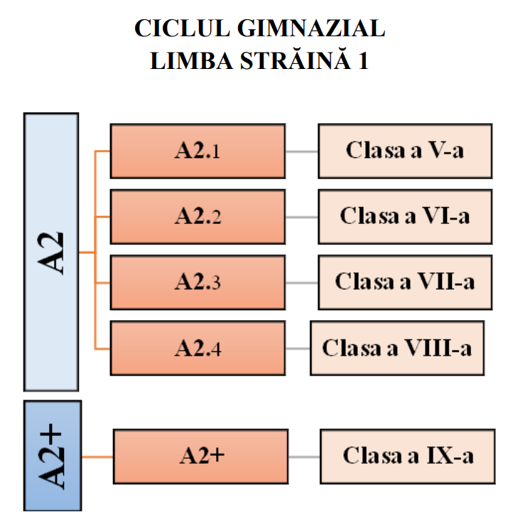
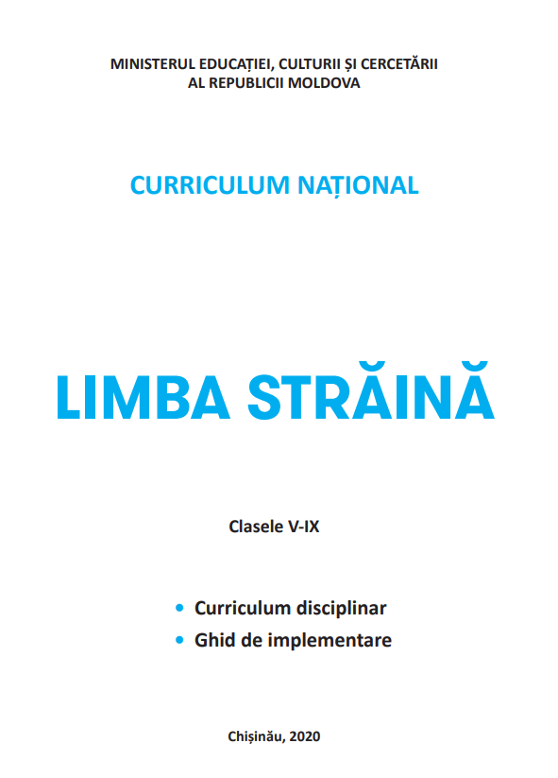

Slide 8
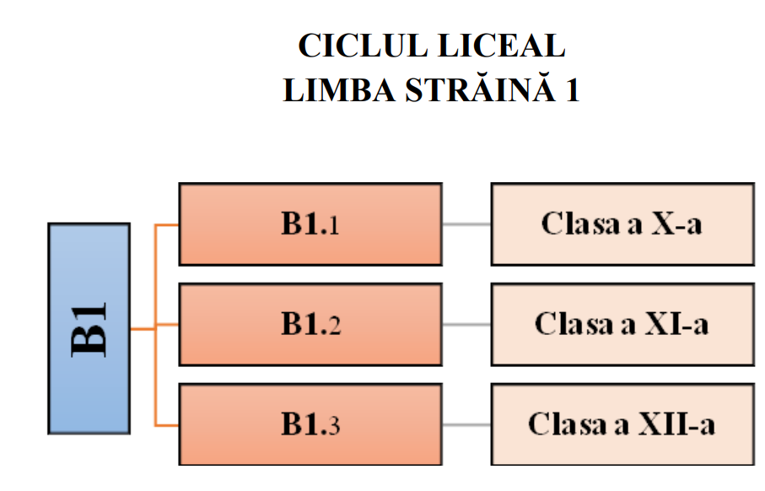
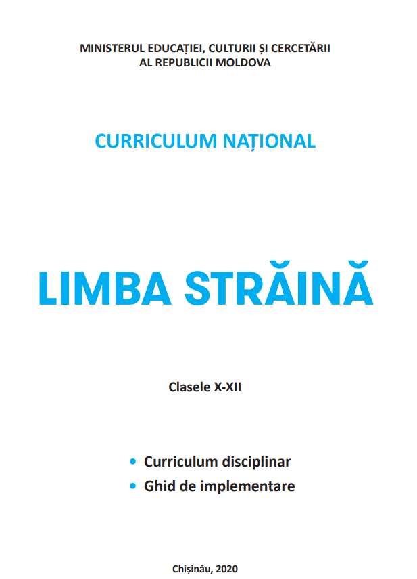

Slide 9
Definition of competence promoted by the Education Code and the Reference Framework of the National Curriculum
"School competence is an integrated system of knowledge, skills, attitudes and values, acquired, formed and developed through learning, the mobilization of which allows the identification and solving of different problems in various contexts and situations”
Key Components:
Integrated Learning: Emphasizes the integration of knowledge, skills, attitudes, and values acquired through education.
Problem-Solving Focus: Mobilizes acquired competences to identify and solve various problems in different contexts and situations.

Slide 10
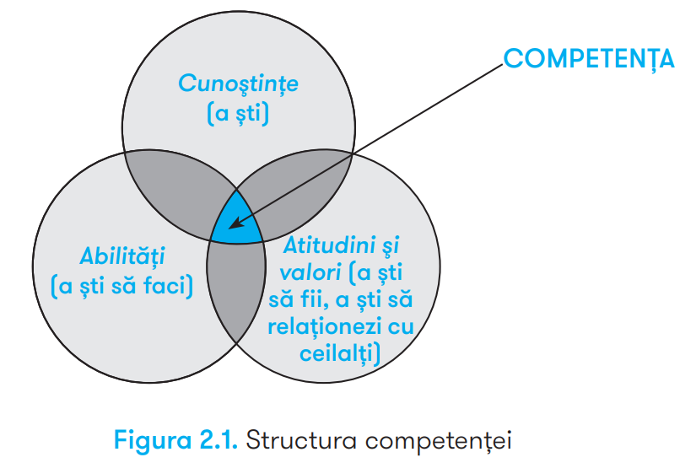
https://mecc.gov.md/sites/default/files/cadrul_de_referinta_final_rom_tipar.pdf, p.19

Slide 11
Key/transversal /trænzˈvɜ:səl/ competences
an important curricular category with a high degree of abstraction and generalization, which mark society's expectations concerning the school policy in regard to the most general performances that can be achieved by students at the end of schooling.
Key competences cross different spheres of social life, have a multi/inter/transdisciplinary character that can be defined within the subject-specific competences, units of competence, content units, learning activities and recommended school products. Its character is formed and progressively developed on levels and cycles of education.
E.g. Lifelong learning
Complex and critical thinking
Effective communication
Collaboration/teamwork
Responsible citizenship, etc.

Slide 12
Subject-specific competences (linguistic, sociolinguistic, pragmatic, pluri/iner cultural)
result from transdisciplinary competences and key/transversal competences and represent integrated systems of knowledge, skills, attitudes and values, which the secondary/high level Foreign Language subject area aims to develop by the end of the secondary education/high education.
Transdisciplinary competences for secondary school:
Competence to use in real situations tools with digital action, demonstrating independence of thought and action.
Competence to think critically about one's work with the aim of continuous self-development and self-fulfilment.
Transdisciplinary competences for the high school level:
The competence to make a conscious choice of future professional activity with a view to self-fulfilment.
The competence to organise one's personal activity in the context of constantly changing technologies, showing self-confidence and success.

Slide 13
SUBJECT-SPECIFIC COMPETENCES
The use of language resources, demonstrating language functionality in a social context.
The use of the linguistic structures in familiar and predictable contexts, demonstrating coherence and accuracy in communication.
Appropriation of elements specific to the culture of the target language countries, expressing sensitivity/openness to the values of another culture and acceptance of cultural diversity.
Application of the linguistic norms in the formation of simple, correct messages, valuing the language as a system.
Linguistic competence:
Sociolinguistic competence:
Pragmatic competence:
(Pluri- / inter-) cultural competence:

Slide 14
Unități de conținut
Mijloace informaționale prin care se realizează unitățile de competențe, i.e. liste de termeni specifici disciplinei./ Information means by which the units of competence are achieved, i.e. lists of subject-specific terms.
Acte comunicative
Activități și produse de învățare
Unități de competențe
Constituente ale competențelor, etape în achiziționarea competențelor specific./Components of competences, stages in the acquisition of specific competences.
Modalități de transmitere a mesajelor prin diferite mijloace de comunicare/ Ways of getting messages across by different means of communication.
Listă deschisă de contexte semnificative de manifestare a unităților de competențe proiectate pentru dezvoltare și evaluare/Open-ended list of significant contexts for the manifestation of the designed units of competence for development and assessment.
Exemplu: Curriculum DISCIPLINA LIMBA STRĂINĂ Clasele V - IX

Slide 15
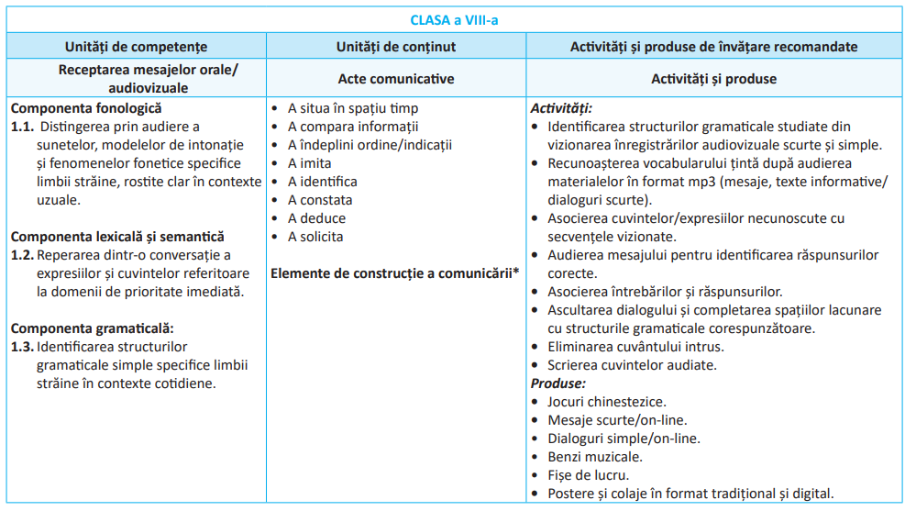

Slide 16
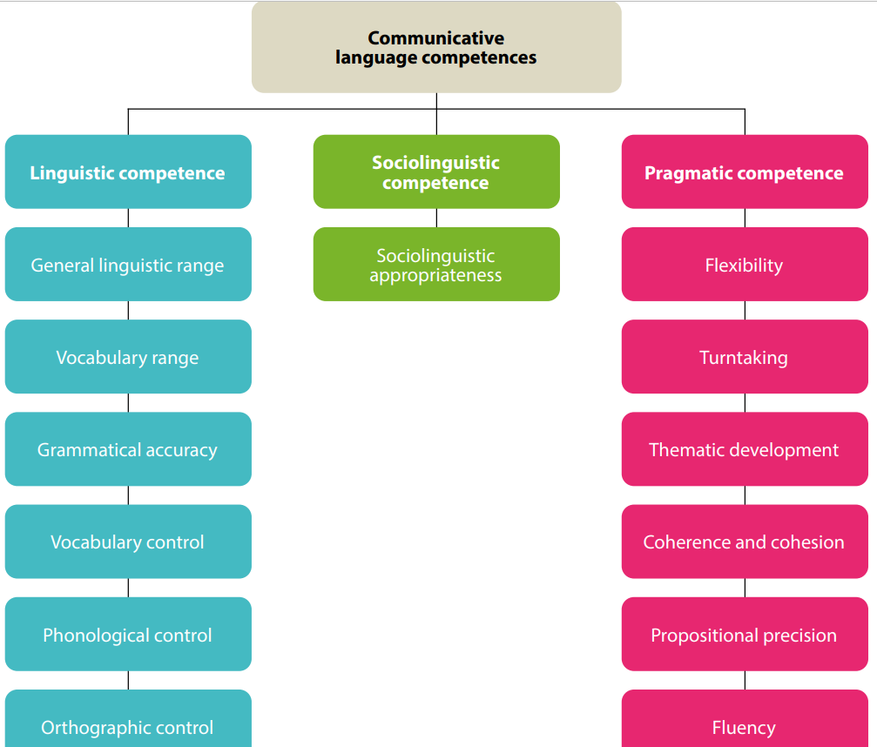
“Linguistic competence”, “Pragmatic competence” and “Sociolinguistic competence” are always intertwined in any language use; they are not separate “components” and cannot be isolated from each other.
COUNCIL OF EUROPE. Common European Framework of Reference for Languages: Learning, Teaching, Assessment. Cambridge: Cambridge University Press, 2001, [online] https://rm.coe.int/1680459f97
THE CEFR ILLUSTRATIVE DESCRIPTOR SCALES: COMMUNICATIVE LANGUAGE COMPETENCEShttps://rm.coe.int/chapter-5-communicative-language-competences/1680a084c3

Slide 17
Intercultural competence:
recognizing and acting on cultural, socio-pragmatic and sociolinguistic conventions/cues;
recognising and interpreting similarities and differences in perspectives, practices and events;
evaluating neutrally and critically.
The capacity to use knowledge of and proficiency (even partial) in one or more languages as leverage for approaching texts in other languages, in order to achieve a communication goal.
As the social agent is building on their pluricultural repertoire, they are also engaged in exploiting all available linguistic resources in order to communicate effectively in a multilingual context and/or in a classic mediation situation in which the other people do not share a common language.

Slide 18
Linguistic competence | is concerned with language usage (as in ‘correct usage’) and hence with language resources, knowledge of the language as a system.
General linguistic range
Vocabulary range
Vocabulary control
Grammatical accuracy
Phonological control
Orthographic control
Lexical competence;
Grammatical competence;
Semantic competence;
Phonological competence;
Orthographic competence;
Orthoepic competence.
COUNCIL OF EUROPE. Common European Framework of Reference for Languages: Learning, Teaching, Assessment. Cambridge: Cambridge University Press, 2001, [online] https://rm.coe.int/1680459f97

Slide 19
Pragmatic competence | is concerned with the user/learner’s knowledge of the principles of language use according to which messages are: organised, structured and arranged (‘discourse competence’); used to perform communicative functions (‘functional competence’); sequenced according to interactional and transactional schemata (‘design competence’).
Discourse competence is the ability of a user/learner to arrange sentences in sequence so as to produce coherent stretches of language. It includes knowledge of and ability to control the ordering of sentences in terms of:
• topic/focus;
• given/new;
• ‘natural’ sequencing: e.g. temporal cause/effect.
• ability to structure and manage discourse in terms of:
thematic organisation;
coherence and cohesion;
logical ordering; style and register;
rhetorical effectiveness;
text design, etc.
Functional competence is concerned with the use of spoken discourse and written texts in communication for particular functional purposes. Microfunctions - categories for the functional use of single utterances, usually as turns in an interaction, e.g. imparting and seeking factual information, expressing and finding out attitudes, suasion, etc.
Macrofunctions are categories for the functional use of spoken discourse or written text consisting of a sequence of sentences, e.g.: description, narration, commentary, exposition, exegesis, explanation, demonstration, instruction, argumentation.
Interaction schemata - knowledge of and ability to use the schemata (patterns of social interaction) which underlie communication, such as verbal exchange patterns. Usually they form pairs:
General Schema for purchase of goods or services, p.127 CEFR, 2001.

Slide 20
Sociolinguistic competence | is concerned with the knowledge and skills required to deal with the social dimension of language use: linguistic markers of social relations; politeness conventions; expressions of folk-wisdom; register differences; dialect and accent.
E.g. Sociolinguistic appropriateness

Slide 21
Plurilingual and pluricultural competence | - involves the ability to call flexibly upon an inter-related, plurilinguistic and a pluricultural repertoire to: ► switch from one language or dialect (or variety) to another; ► express oneself in one language (or dialect, or variety) and understand a person speaking another; ► call upon the knowledge of a number of languages (or dialects, or varieties) to make sense of a text; ► mediate between individuals with no common language (or dialect, or variety), even with only a slight knowledge oneself; ► bring the whole of one’s linguistic equipment into play, experimenting with alternative forms of expression; recognising and acting on cultural, socio-pragmatic and socio-linguistic conventions/cues; ► recognising and interpreting similarities and differences in perspectives, practices, events; ► evaluating neutrally and critically.

Slide 22
Building on pluricultural repertoire
Pluricultural comprehension
Building on plurilingual repertoire

Slide 23
Match the definitions below with the following communicative language competences: lexical competence; grammatical competence; semantic competence; phonological competence; orthographic competence; sociolinguistic competence, discourse competence, functional competence:
? | knowledge of, and ability to use, the vocabulary of a language, consists of lexical elements and grammatical elements.
? | deals with the learner’s awareness and control of the organisation of meaning.
? | knowledge of, and ability to use, the grammatical resources of a language.
? | knowledge of, and skill in the perception and production of: the sound-units of the language and their realisation in particular contexts; the phonetic composition of words (syllable structure, the sequence of phonemes, word stress, word tones); sentence stress and rhythm, intonation.
? | is concerned with the use of spoken discourse and written texts in communication for particular functional purposes.
? | is concerned with the knowledge and skills required to deal with the social dimension of language use: linguistic markers of social relations; politeness conventions; expressions of folk-wisdom; register differences; and dialect and accent.
? | is the ability of a user/learner to arrange sentences in sequence so as to produce coherent stretches of language. It includes knowledge of and ability to control the ordering of sentences in terms of: • topic/focus; • given/new; • ‘natural’ sequencing: e.g. temporal; • cause/effect; • ability to structure and manage discourse in terms of: thematic organization; coherence and cohesion; logical ordering; style and register; rhetorical effectiveness; etc.
? | knowledge of and skill in the perception and production of the symbols of which written texts are composed.

Slide 24
Choose from the list below:
lexical competence; grammatical competence; semantic competence; phonological competence; orthographic competence; sociolinguistic competence, discourse competence, functional competence:
knowledge of, and ability to use, the vocabulary of a language, consists of lexical elements and grammatical elements.
knowledge of, and ability to use, the grammatical resources of a language.
deals with the learner’s awareness and control of the organization of meaning.

Slide 25
Choose from the list below:
lexical competence; grammatical competence; semantic competence; phonological competence; orthographic competence; sociolinguistic competence, discourse competence, functional competence:
knowledge of, and skill in the perception and production of the sound-units of the language and their realization in particular contexts; the phonetic composition of words (syllable structure, the sequence of phonemes, word stress, word tones); sentence stress and rhythm, intonation.

Slide 26
Choose from the list below:
lexical competence; grammatical competence; semantic competence; phonological competence; orthographic competence; sociolinguistic competence, discourse competence, functional competence:
is concerned with the use of spoken discourse and written texts in communication for particular functional purposes.

Slide 27
Choose from the list below:
lexical competence; grammatical competence; semantic competence; phonological competence; orthographic competence; sociolinguistic competence, discourse competence, functional competence:
is concerned with the use of spoken discourse and written texts in communication for particular functional purposes.

Slide 28
Choose from the list below:
lexical competence; grammatical competence; semantic competence; phonological competence; orthographic competence; sociolinguistic competence, discourse competence, functional competence:
is concerned with the knowledge and skills required to deal with the social dimension of language use: linguistic markers of social relations; politeness conventions; expressions of folk-wisdom; register differences; and dialect and accent.

Slide 29
Choose from the list below:
lexical competence; grammatical competence; semantic competence; phonological competence; orthographic competence; sociolinguistic competence, discourse competence, functional competence:
is the ability of a user/learner to arrange sentences in sequence so as to produce coherent stretches of language. It includes knowledge of and ability to control the ordering of sentences in terms of:
• topic/focus;
• given/new;
• ‘natural’ sequencing: e.g. temporal;
• cause/effect;
• ability to structure and manage discourse in terms of: thematic organization; coherence and cohesion; logical ordering; style and register; rhetorical effectiveness; etc.

Slide 30
Choose from the list below:
lexical competence; grammatical competence; semantic competence; phonological competence; orthographic competence; sociolinguistic competence, discourse competence, functional competence.
knowledge of and skill in the perception and production of the symbols of which written texts are composed.
The ability to produce a correct pronunciation from the written form. It involves
knowledge of spelling conventions
ability to consult a dictionary and a knowledge of the conventions used there for the representation of pronunciation
knowledge of the implications of written forms, particularly punctuation marks, for phrasing and intonation
ability to resolve ambiguity (homonyms, syntactic ambiguities, etc.) in the light of the context

Slide 31
Teaching and Learning Methodology Promoted in the Curriculum for the Secondary School.
Spiral organization through progressive acquisitions.
Emphasis on oral skills followed by written proficiency.
Use of mediation and continuous reformulation based on descriptors (CEFR, 2018).
Focus on communicative-situational aspects over grammar (morphology/syntax).
Usage of intuitive or deductive approaches without strict metalanguage specification.
Automated assimilation through varied exercises (oral, written, online) and dialogues.
Development of grammatical categories based on real-life situations and contexts;
Grammar as a means to an end, not an end in itself; importance of appropriate grammatical categories in communication.
The process of providing language material will be carried out on the basis of an active vocabulary of high-frequency active vocabulary.
Relevance of linguistic material to students' interests and daily life.
Using visual aids, charts, and relevant images to enhance the presentation as needed.
Thematic Modules:
Order determined by specific learning units and everyday usage.
Connection to real-life situations, texts, and active tasks.
Inclusion of basic vocabulary (200-250 words per grade) tailored to students' daily experiences (secondary level).
Continuous adaptation to enhance students' communication skills in various contexts.

Slide 36
Examples of mediation-based activities:
retelling the key information from a text orally or in written form;
explaining the information presented in diagrams, graphs, tables in oral or written form;
oral or written retelling of a written text;
taking notes during lectures, seminars, or meetings;
personal presentation on creative and literary texts;
reflection on the messages from creative, literary, and non-literary texts;
facilitating collaboration within a group to reach consensus;
facilitating the interaction between the members of a group;
establishing a positive atmosphere of collaboration and mutual understanding;
facilitating in informal situations with friends and colleagues;
explaining a new concept;
adapting ones’ linguistic repertoire to new situations; interaction in the online environment;
plurilingual and intercultural interaction.

Slide 37
Methodological alternatives of teaching-learning-assessment
Active Learning: Unlocking Student Potential
Active Learning involves the use of methods, techniques and procedures that actively involve the student in the learning-teaching-assessment process.
Objectives:
Critical Thinking: Fosters the development of critical thinking skills.
Creativity: Stimulates creativity, encouraging innovative problem-solving.
Real-world Application: Helps students apply school learning to diverse real-life situations.
Responsibility: Empowers students to take ownership of their own learning success.
Examples of Active Learning:
Digital Film Production: Creating films (for international) presentations.
Interactive Posters: Designing traditional/digital posters summarizing lessons/modules.
Debates: Engaging in structured discussions, exploring pros and cons.
Active participation at every learning stage enhances understanding, fostering a dynamic learning environment.

Slide 38
Discovery Learning: Fostering Independent Inquiry
Discovery Learning places students as seekers of scientific knowledge, empowering them to uncover truth through independent exploration.
Methodology:
Problem-Based Approach: Learning occurs within a problem-solving and debate framework.
Independent Exploration: Students face unfamiliar problems, requiring creative solutions and intuition.
Process of Discovery: Involves organizing, correlating, and interpreting data, applying critical thinking, intuition, imagination, and creativity.
Examples of Discovery Learning:
Language Analysis: Analyzing foreign language elements, such as sounds, intonations, and pronunciation patterns from media like films, cartoons, or books.
Case Study Discussions: Engaging in discussions based on real-life case studies, encouraging critical analysis.
Interactive Projects: Creating interactive posters (traditional/digital), engaging in online communication with international peers, fostering global awareness.
Benefits:
Authentic Engagement: Encourages authentic, real-world activities, motivating students to explore and discover beyond classroom boundaries.
Critical Skills Development: Enhances problem-solving, critical thinking, and creative abilities, preparing students for diverse challenges.

Slide 39
Task-Based Learning: Enhancing Practical Skills
involves students tackling problems, both in content and organization, fostering skills like time management, planning, teamwork, research, and identifying tools.
Skills Developed:
Time Management: Learning to manage tasks within designated time frames.
Planning: Structuring work, setting goals, and organizing resources effectively.
Teamwork: Collaborating with peers, honing communication and cooperation skills.
Resource Management: Obtaining materials, selecting relevant information, and utilizing tools efficiently.
Flexibility and Adaptability:
Customizable Workload: Students can adjust tasks based on abilities, promoting a tailored learning experience.
Holistic Skill Development: Enhances both language competences and vital career skills.
Practical Examples:
National Custom Presentation: Creating cartoons/comic strips to explain cultural traditions.
Tourist Brochure Project: Developing brochures highlighting local historical sites.
Personal Interest Presentation: Crafting traditional/digital presentations about individual interests.
Benefits:
Engaging Learning: Encourages practical, hands-on activities, making learning enjoyable and interactive.
Skill Diversity: Challenges students to acquire diverse skills, preparing them for real-world challenges and successful careers.

Slide 40
Problem-Based Learning: Fostering Autonomy and Creativity
- is a learner-centered approach where teachers act as facilitators. It involves cases or constructed scenarios, serving as starting points for students to explore information, form opinions, and devise diverse solutions, promoting active engagement and critical thinking.
Autonomy and Responsibility:
Student Autonomy: Students define goals, research, and learn independently.
Responsibility: Implies accountability for sourcing information and problem-solving strategies.
Practical Examples:
Scholarship Application: Creating a digital CV to secure a scholarship or participate in a school competition.
Environmental Awareness: Developing an artistic collage addressing environmental issues and solutions.
Local Promotion: Crafting an advertisement to promote a local product or brand.
Benefits:
Enhanced Creativity: Encourages students to explore inventive solutions, honing creative and innovative skills.
Critical Thinking: Challenges students to analyze problems critically, fostering problem-solving abilities.
Real-world Application: Prepares students for practical challenges, bridging classroom knowledge with real-life scenarios.

Slide 41
Project-Based Learning: Real-World Engagement, Authentic Learning
- engages students in exploring compelling problems and creating authentic products. Projects stem from challenging questions, driving active roles like problem solvers, decision makers, and investigators.
Active Participation:
Problem Solvers: Tackling real-life issues, fostering critical thinking and problem-solving skills.
Decision Makers: Making informed choices, enhancing decision-making abilities.
Investigators: Researching topics, honing research skills for in-depth understanding.
Documentation Managers: Organizing findings, developing essential organizational skills.
Authentic Experiences:
Real-Life Context: Projects reflect genuine problems, connecting classroom learning to the real world.
Professional Roles: Sts adopt roles akin to professionals in specific fields, enhancing practical understanding.
Examples of Projects:
Environmental Documentary: Creating a documentary addressing environmental concerns, promoting awareness.
Historical Tourist Brochure: Designing brochures showcasing local historical sites, promoting community heritage.
Mall Construction Analysis: Preparing multimedia presentations evaluating the pros and cons of building a mall, encouraging critical analysis.
Benefits:
Real-Life Significance: Sts engage in activities with relevance beyond the classroom, fostering a sense of purpose.
Skill Development: Enhances critical thinking, research, decision-making, and presentation skills.
Intrinsic Motivation: Sts find motivation in the authentic nature of the projects, encouraging active participation.

Slide 42
References:
CURRICULUM NAȚIONAL, Învățământul primar, LIMBA STRĂINĂ I. Curriculumul disciplinar, Ghidul de implementare a curriculumului disciplinar, Chișinău, 2018, online https://mecc.gov.md/sites/default/files/curriculum_limba_straina_primar_tipar.pdf?fbclid=IwAR2znxT0x-deshMWRk4pXS2pQ48X8B9tXpol48ahO9ZNV4okMCKqBiKH6tk
CURRICULUM NAȚIONAL, LIMBA STRĂINĂ, Clasele V-IX. Curriculum disciplinar. Ghid de implementare, Chişinău, 2020, online https://mecc.gov.md/sites/default/files/limba_straine_gimnaziu.pdf
CURRICULUM NAȚIONAL LIMBA STRĂINĂ Clasele X-XII. Curriculum disciplinar. Ghid de implementare, Chişinău, 2020, online https://mecc.gov.md/sites/default/files/limba_straine_liceu.pdf
REPERE METODOLOGICE PRIVIND ORGANIZAREA PROCESULUI EDUCAȚIONAL LA DISCIPLINA ȘCOLARĂ LIMBA STRĂINĂ ÎN ANUL DE STUDII 2022-2023 https://mecc.gov.md/sites/default/files/repere_metodologice_l.straina_2022-2023_final.pdf

